Slide 1
Spill Response

Slide 2
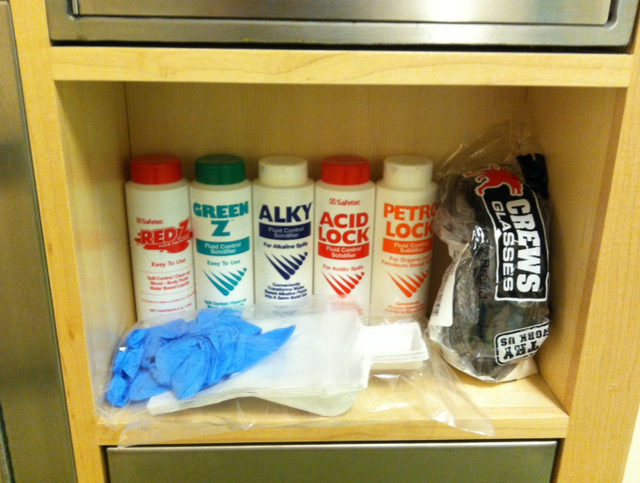
Ragon Spill Kits
For small spill response
2 on each floor
Contain:
Nitrile gloves
Safety goggles
Dustpan and brush
Scoop
Hazardous waste bag
Spill Absorbent for chemicals and biologicals (BSL-1 or non infectious body fluids)
Notify EH&S if you use any of the materials

Slide 3
Can I Clean it Up?
Spill
Not hazardous to health
Small Spill
Large Spill
Hazardous to health
Evacuate Area
Warn Others
Do Not Attempt Clean Up
Clean up using Spill Kit
Evacuate Area
Warn Others
Do Not Attempt To Clean Up
If the volume of spilt material cannot be contained with the absorbents available in the spill kit or it is an acutely hazardous material, do not attempt to clean up.

Slide 4
Other Factors to Consider
Before deciding whether to tackle a spill clean-up there are some further factors to consider:
It is chemical or biological? This determines how we approach the spill.
Will you risk further exposure to yourself or others if you attempt to clean it up?
Do you have a clear plan for the clean-up process and debris disposal?
Are you comfortable performing the spill clean-up? If not contact EH&S, do not put yourself in harms way.

Slide 5
In the event of a hazardous spill please contact:
During normal working hours (M-F 8am-5pm):
Matt Bedford 617-293-0333
AJ Troiano 781-707-8438
Ragon Lab Managers
Ragon Spill Response Volunteer Team
Outside of normal hours and weekends:
ARE Security Desk
300 Tech Square
617-577-9177

Slide 6
BSL 2+

Slide 7
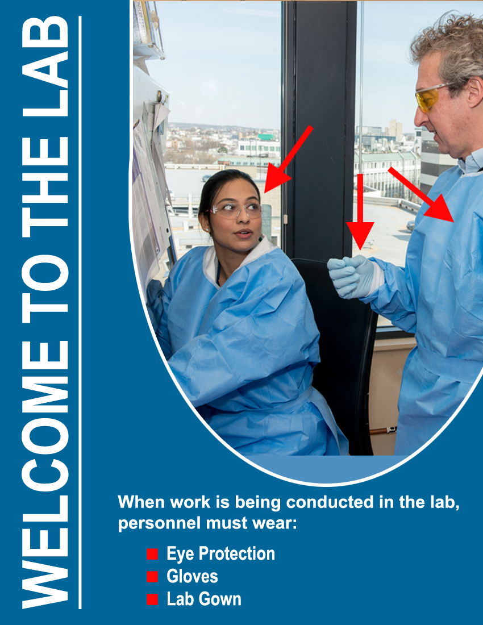
4) BSL2+ (Tissue culture spaces):
When work is being
performed:
Safety glasses
Disposable gloves
Solid front disposable gown

Slide 8
When no work is being performed:
Disposable gloves (mandatory)
Safety glasses (mandatory for some rooms, highly advised for all other rooms)

Slide 9
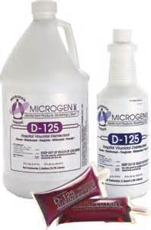
BL2+ Safety and Proper operation
2nd Pair of gloves –ONLY IN THE HOOD
Proper bucket, squeeze bottle and flask preparation and disposal (buckets refreshed with D125 daily).
Do not let autoclave waste build up
Keep Tissue Culture Room clean and organized
Remove trash, cardboard boxes and unwanted items regularly
1:64
Notes:
Gloves only in the hood / check for supplies before so you don’t have to leave in sec/ make hole in the bag and fill ½ bucket / check if Vaccum flask is not too full
Helpa filters must be clean/ gauze to cover spills/ d125 and alcohol/ aspirate liquid after inactivating labware/ be organized – it is not your personal bedroom but lab space you share/ be an example to

Slide 10
NEVER in the TC room!!!
Wear headphones or earbuds
Use cell phone
Touch anything with bare hands
Use sharps (unless you have and approved SOP)
Leave your work space without cleaning it

Slide 11
Common TC Room Inspection Findings
Buckets, flasks and squeeze bottles dated greater than 7 days (D125 becomes less effective over time. The above items should replaced every 7 days).
Eyewash or Safety Shower blocked (Minimize clutter and equipment to ensure sink and wall mounted emergency equipment is accessible at all times).
Accumulation of autoclave waste on the TC Room floor (Autoclave waste regularly. If autoclave is broken, work with lab managers to come up with an alternate plan).

