Slide 1
Shipping Category A and B

Slide 2


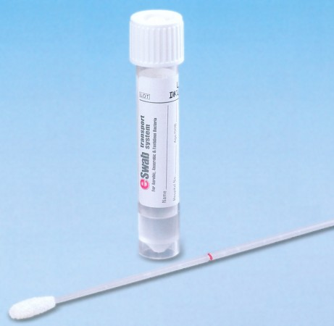
Biological Substance Category B

Slide 3
Biological Substance Category B - Packaging
Packing Instructions 650
  Good condition, rated for air shipments (UNPOP not required)
  Watertight primary receptacle
  Watertight secondary packaging
  Absorbent material between primary and secondary container
  Multiples wrapped individually
  Itemized list between secondary packaging and outer packaging
  Sturdy outer packaging

Slide 4

Category B Packaging and Labeling
Packing Instructions 650
Air-rated packaging (kits are available)
Use Triple Packaging Rules
Label with UN ID and Proper Shipping Name

Slide 5


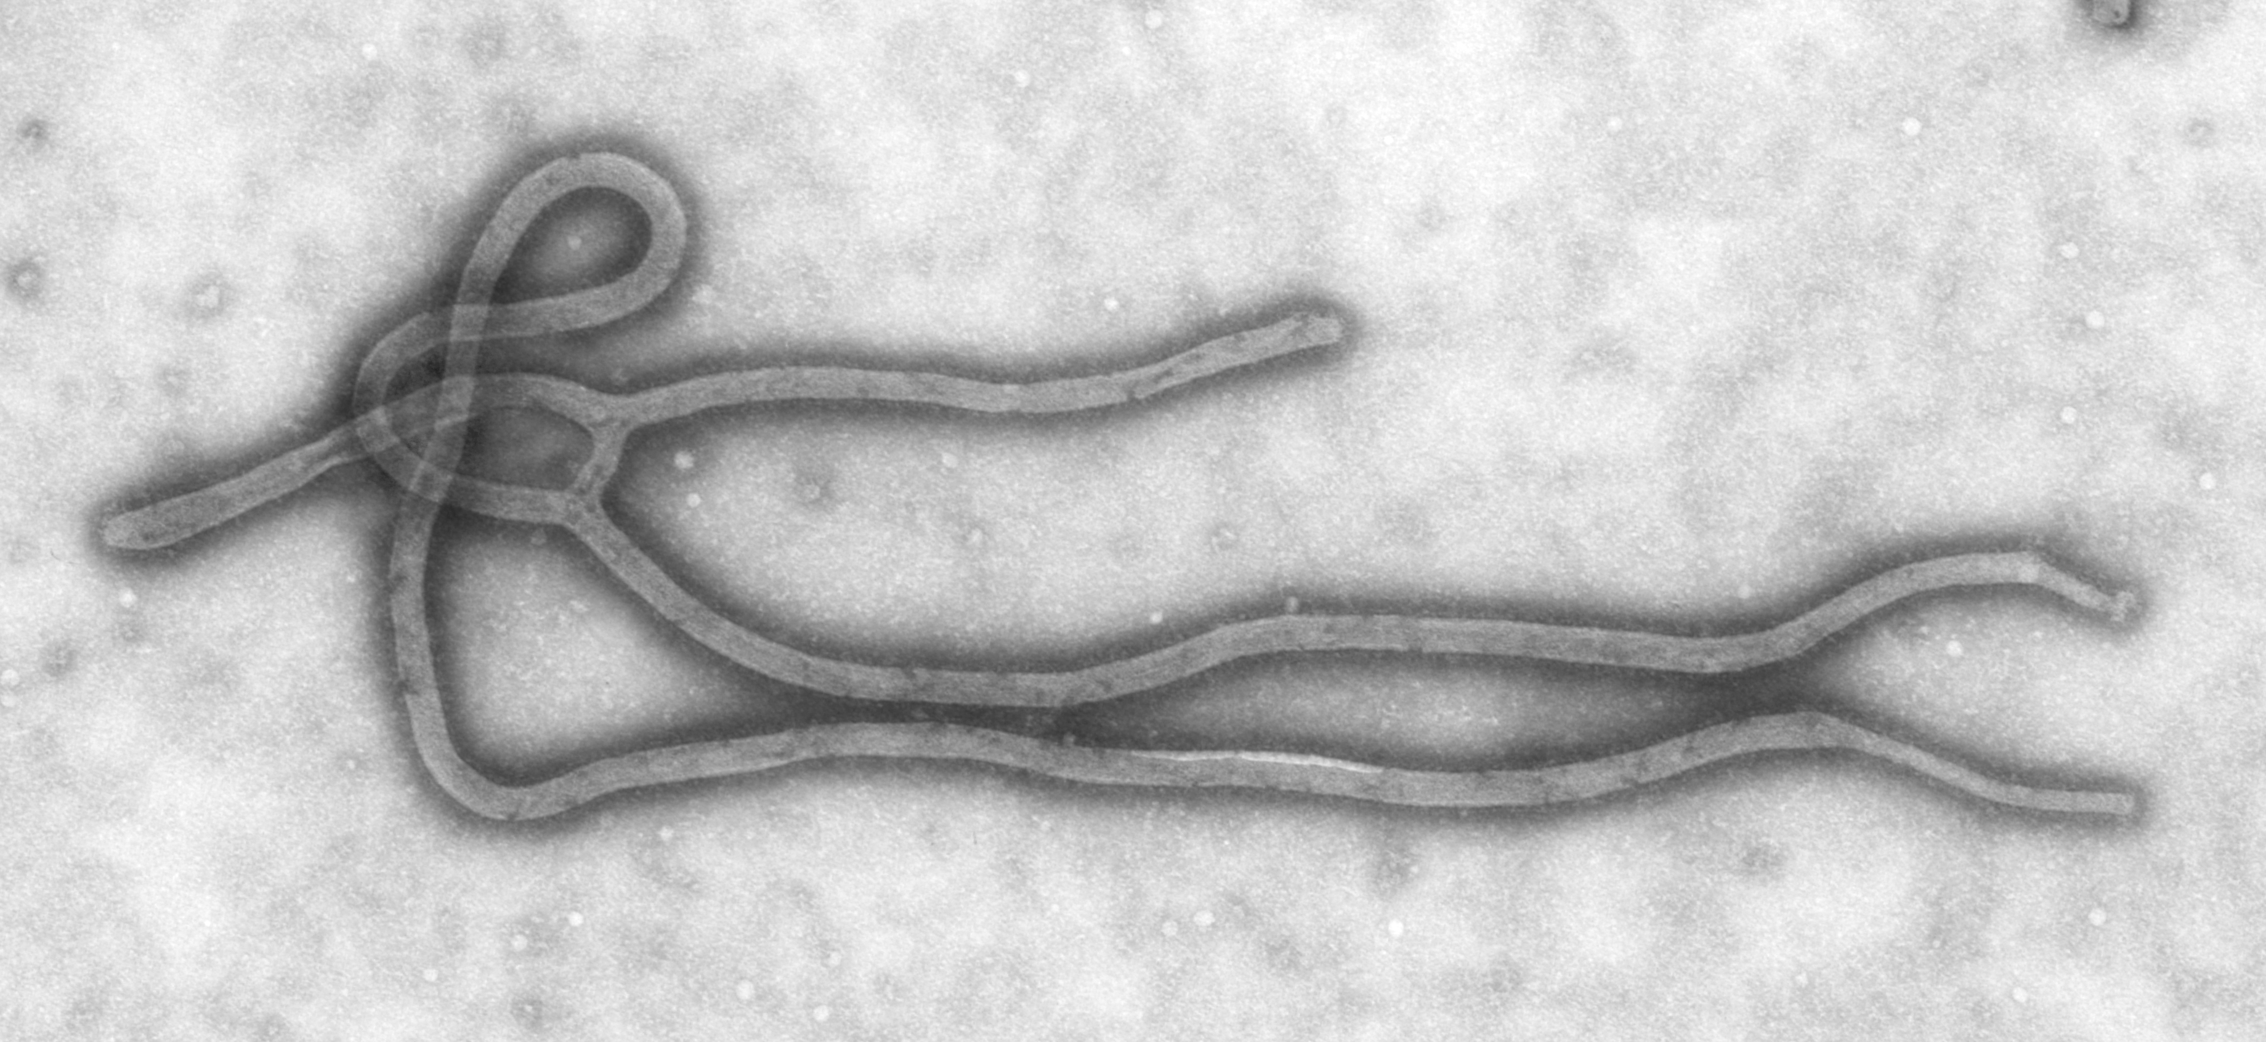
CATEGORY A INFECTIOUS SUBSTANCE

Slide 6
CATEGORY A INFECTIOUS SUBSTANCE
An infectious substance which when transported, will result in permanent disability, or a life-threatening or fatal disease to humans or animals if an exposure occurs.
  Pathogens cultured intentionally for lab stock
  Potential bioterrorism agents
UNPOP Packaging Required
Shipper’s Declaration Required
24-hr Emergency Contact Number Required

Slide 7
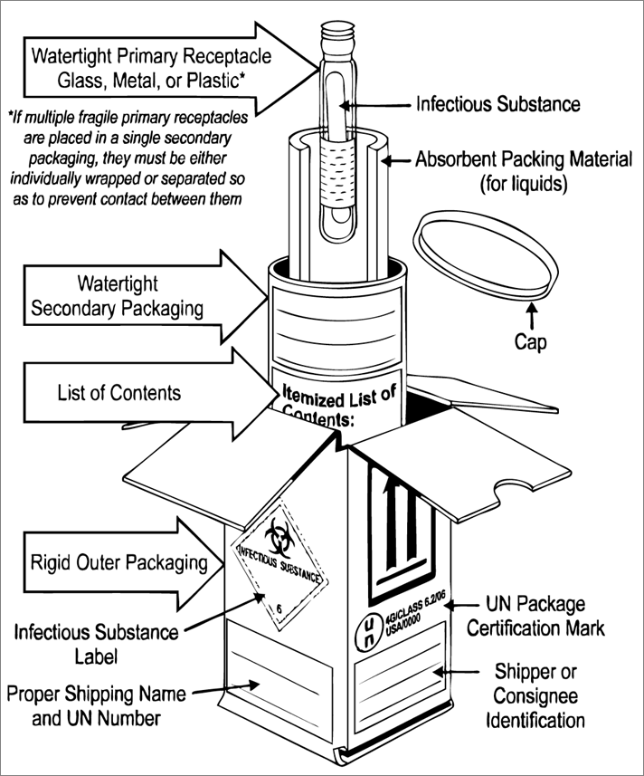
Category A Packaging
Packing Instructions 620
  Good condition
  Watertight primary receptacle
  Watertight secondary packaging
  Absorbent material between primary and secondary container
  Multiples wrapped individually
  Itemized list between secondary packaging and outer packaging
  Outer packaging must be at least 4” in the overall dimension

Slide 8

Category A Marking/Labeling
Class 6 Label
Proper Shipping Name
  UN 2814, Infectious Substance, Affecting Humans
  UN 2900, Infectious Substance, Affecting Animals
Sender and recipient name, address, phone numbers
24-hour Emergency Phone Number
If using a commercial emergency response emergency phone service, include service contract number.

Slide 9
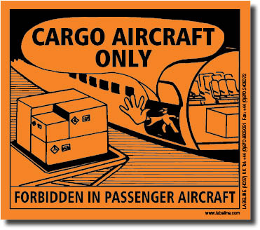
Category A Marking/Labeling
If amount of Category A exceeds 50 milliliters or 50 grams, a Cargo Aircraft Only Label must go on the package.
No more than 4L or 4KG of a Category A per package for cargo aircraft shipments.

Slide 10
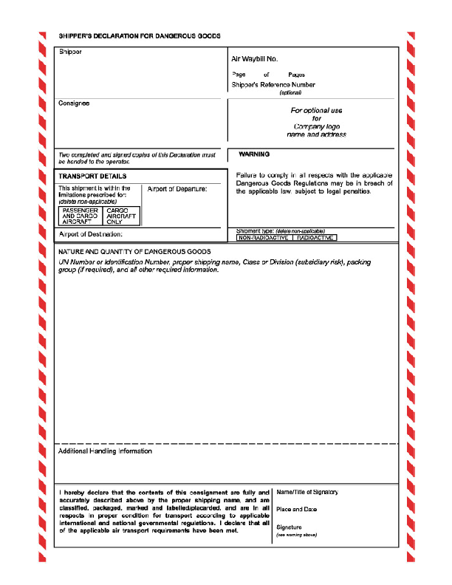
Shipper’s Declaration Form
A Shipper’s Declaration Form required for all Category A packages
Technical name required in parenthesis on this form (e.g. (Dengue Virus)
Technical name not recommended on outer box
Refer to Figures 8.1.I and 8.1.J in IATA DGRs for proper language

