Slide 1
Transportation of Infectious Substances
(Regulated Medical Waste)

Slide 2
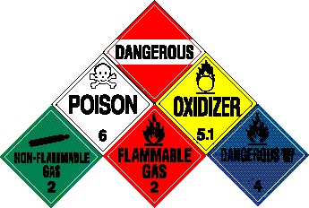
Basic USDOT Definition of Hazardous Material
A substance or material, that when transported in commerce, is capable of posing an unreasonable risk to:
  Health
  Safety
  Property
  Environment
Notes:
Any material that can burn, explode, react violently, cause injury or harm

Slide 3
The Federal Hazardous Materials Transportation Law
49 U.S.C. § 5101 et seq. is the basic statute regulating hazardous materials transportation in the United States.
Purpose: to “protect against the risks to life, property, and the environment that are inherent in the transportation of hazardous material in intrastate, interstate, and foreign commerce” (emphasis added)
Gives the Secretary of Transportation the authority to:
  Designate material as hazardous
  Issue regulations for the safe and secure transportation of hazardous material

Slide 4
Who Is Subject to the Hazardous Material Regulations?
All persons who:
Transport hazardous materials in commerce
Offer hazardous materials for transportation
Are involved in producing hazmat packaging
Prepare or accept hazmat shipments
Are responsible for hazmat safety
Certify compliance with any requirement under the federal hazmat law

Slide 5
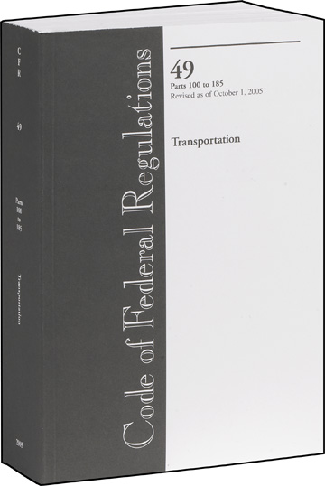
Hazardous Materials Standards
The HMR set forth standards for:
Classification
Packaging
Shipping Papers and Placards
Emergency response information
Hazmat employee training
Hazmat transportation by various modes
Incident reporting
Emergency response information
Security

Slide 6
USDOT Hazmat Classification System
Class 1: Explosives
1.1 Mass explosion hazard
1.2 Projection hazard
1.3 Predominately a fire hazard
1.4 No significant blast hazard
1.5 Very insensitive explosives; blasting agents
1.6 Extremely insensitive detonating substances
Class 2: Gases
2.1 Flammable gas
2.2 Non-Flammable compressed gas
2.3 Poisonous gas
Class 3: Flammable and Combustible Liquids
Class 4: Flammable Solids
4.1 Flammable solid
4.2 Spontaneously combustible material
4.3 Dangerous when wet material
Class 5: Oxidizing Agents & Organic Peroxides
5.1 Oxidizer
5.2 Organic peroxide
Class 6: Toxic & Infectious Substances
6.1 Poisonous materials
6.2 Infectious substance (Etiologic agent)
Class 7: Radioactive Material
Class 8: Corrosive Material
Class 9: Miscellaneous Hazardous Materials

Slide 7
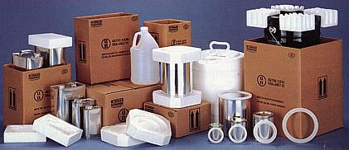
General Package Requirements in the HMR
The hazmat packaging must be:
Able to contain the material
Compatible with the material
Authorized for the material
Closed securely
Filled appropriately

Slide 8
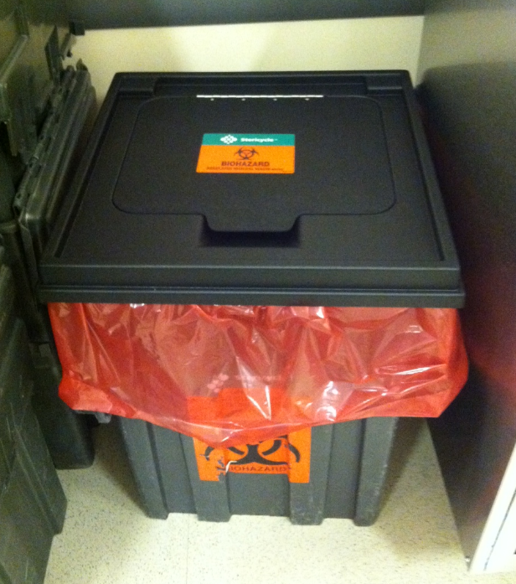
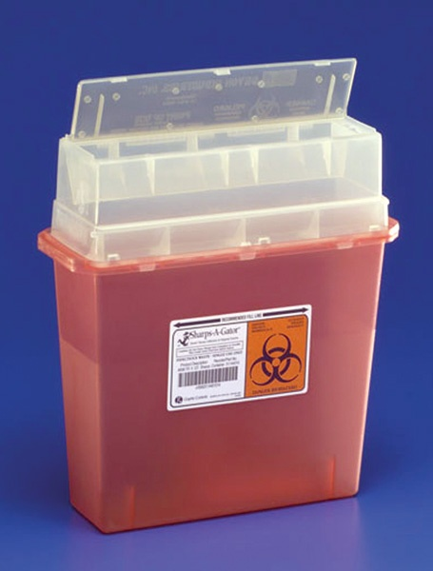

Slide 9
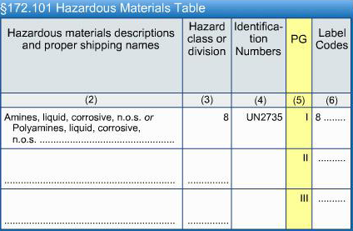
HMT Column 5 – Packing Group (PG)
Assigned according to the relative degree of danger posed by the hazmat during transport:
  PGI greatest
  PGII medium
  PGIII minor

Slide 10
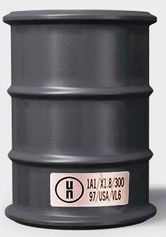
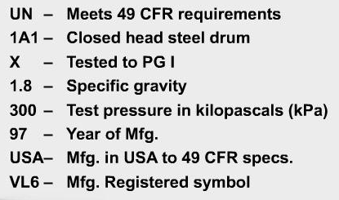
Package Marking Requirements

Slide 11
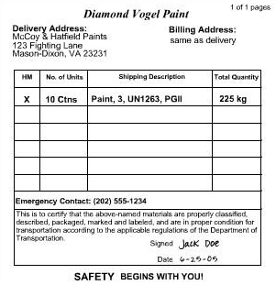
General Shipping Paper Requirements
Legibility
Multiple-page shipping papers
Continuously monitored emergency response telephone number
Documents and forms
UN1263, Paint, 3, PGII

Slide 12
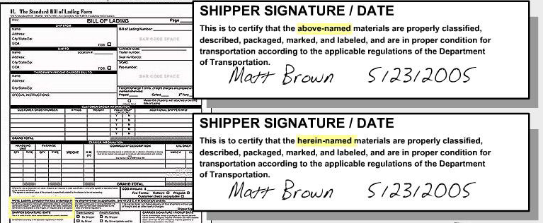
Shipper Certifications

Slide 13
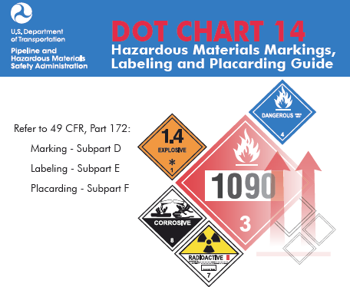
Marking, Labeling, and Placarding
Each hazmat package, freight container, and vehicle must communicate hazard information as prescribed in the HMR.

Slide 14
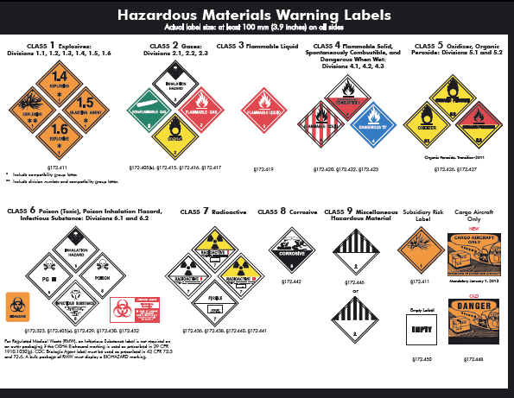

Slide 15
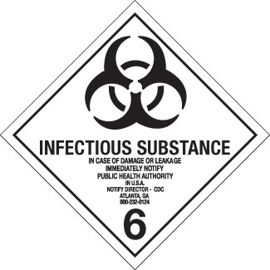

Slide 16

Required Hazmat Training
Hazmat employers must certify the training of employees who perform functions such as load, unload, or handle the shipment of hazmat, prepare hazmat shipping papers, prepare hazmat shipments for transport, or operate a vehicle moving hazmat.
Training must include:
  General awareness/familiarization
  Function-specific/mode-specific training
  Safety training
  Security awareness training
  In-depth security training for some employees (see §172.800)
Initial training required within 90 days
DOT requires retraining and testing at least once every 3 years.
FAA requires air carrier employee training every 2 years.

Slide 17
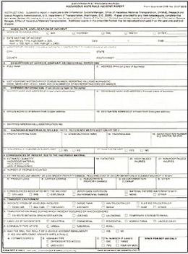
Incident Reporting
Many incidents resulting in an unintentional hazmat release must be reported to the National Response Center (NRC) and, in some cases, the Center for Disease Control (CDC).
  Some require a telephone report within 12 hours.
  All require a written report within 30 days.
Radioactive materials – notify NRC within 12 hours
Infectious substances – notify CDC within 12 hours
Marine pollutants – notify NRC within 12 hours of any release of:
  Solid greater than 400 Kg (882 lb)
  Liquid greater than 450 L (119 gal)

Slide 18
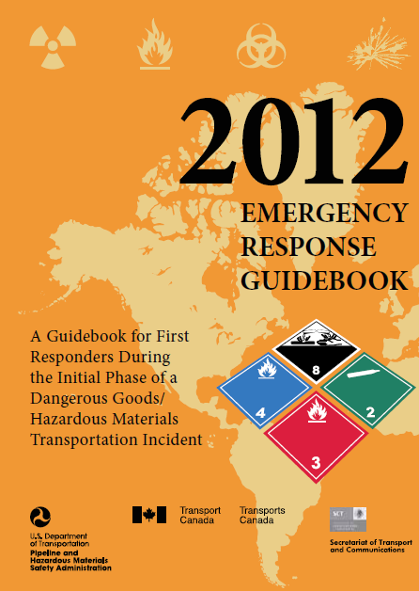
2012 Emergency Response Guidebook (ERG)
The ERG provides information to first responders to a hazmat incident to help them quickly:
  locate shipping papers
  identify the dangerous goods involved
  take initial actions to protect themselves and the general public

Slide 19
Summary
For shipping Regulated Medical Waste at Ragon we must
Be familiar with the nature of the material
Ensure it is packaged properly
Check that manifest correctly reflects the material being shipped
Understand the importance of signing the manifest
Be aware of security and emergency response role

