Slide 1
Evacuation

Slide 2
Emergency Preparedness
Emergency preparedness is key to successfully evacuating a building in an emergency such as a fire.
Everyone must do their part:
Participate in fire drills
Keep emergency egress routes clear
Report any safety-related issues to EH&S

Slide 3
Your Responsibilities
Evacuate as instructed
Take badge, keys, coat only if safe to do
so….do not delay exit!
Refusing to evacuate is a personal finable offense$$$ from City of Cambridge Fire Department!
Meet your group at Rally Point in center of courtyard
DO NOT go for coffee or leave area!
Wait with group until instructed to re-enter the building

Slide 4
Floor Warden Responsibilities
Wear Floor Warden Hat (yellow or orange)
Coordinate Evacuation In An Orderly Fashion
Check To Ensure Evacuation Is Complete
Direct All Employees To “Rally Point”
Coordinate Re-Entry
Utilize Fire Drill Checklist

Slide 5
Alarm Sequence of Events
Pre-tone/ Strobe light
Pre-Recorded Message
Plays twice
Evacuation Tone
Instructional Message
Listen & Respond

Slide 6
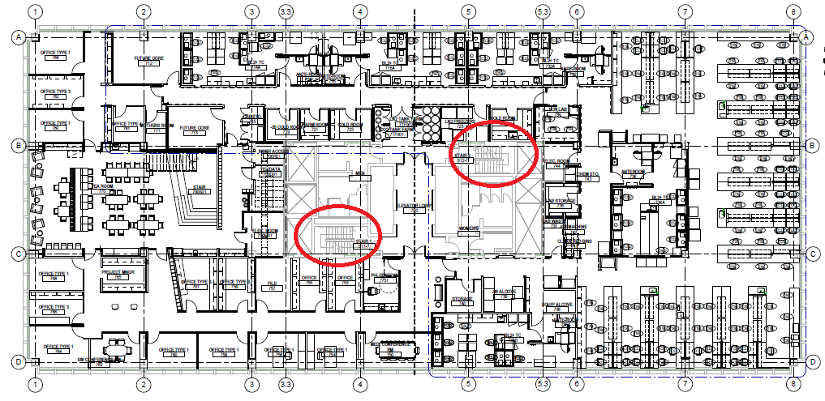
Evacuation Stairwells
DO NOT USE ELEVATORS

Slide 7
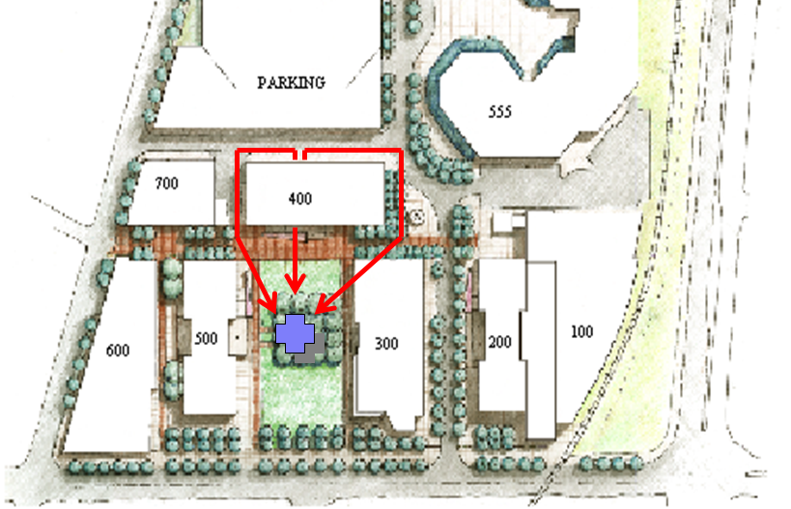
Evacuation Route to Rally Point

Slide 8
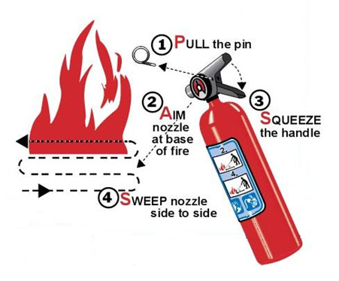
Fire Extinguisher
Only use if means of egress is blocked. Procedure = PASS
Pull the pin out of the fire extinguisher
Aim at the base of the fire using the hose
Squeeze the handle
Sweep from side to side

Slide 9
Incidents

Slide 10
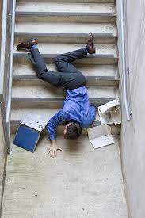
Examples of Incidents
Notes:
Accidents or injuries can happen in the office as well as in the lab.
Be aware of your surroundings.
Don’t rely on common sense to keep you safe. Utilize SOP’s, checklists, pre-task meetings etc to identify and mitigate all the risks associated with the task.
If you are unsure or uncomfortable with the safety aspects of the task STOP WORK, discuss with your lab manager, PI, or EH&S

Slide 11
Lab Post Potential Exposure Protocol
WASH - affected area for 15 minutes with soap and water
You (or a “buddy”) should gather the PEP Checklist Information
CALL- Occupational Health (617) 726-2217
CALL - Contact supervisor and/or Clinician Researcher listed, review incident and Occupational Health recommended response
GO- to MGH Occupational health or as directed by them
REPORT- Within 24 hours, you (or a “buddy”) should fill out an incident report

Slide 12
Safety Reporting System
Report all injuries/illnesses/accidents using the MGH Safety Reporting system
Needs to be done on a Partners Computer
Instructions on the Ragon intranet EHS page
http://intranet.massgeneral.org/PARC/ehs.html
OR
Partners tab→ Safety reporting MGH
Notes:
Accident investigation is NOT an exercise in pointing fingers, reprimanding or apportioning blame.
We want to make sure that you have received any necessary medical care, are safe and to make sure it does not happen to you or a colleague again

