Slide 1
Hazard Communication Program

Slide 2
Hazard Communication Program
Often referred to as “Right to Know” or simply “HazCom”, OSHA’s Hazard Communication Standard is designed to give workers easily accessible information about the hazards associated with the chemicals they are using. To be compliant with the HazCom Standard Ragon must ensure that:
There is a written plan that describes how the standard will be implemented.
All containers of hazardous chemicals are labeled, tagged, or marked with the identity of the material and appropriate hazard warnings.
Each employee who may be exposed to hazardous chemicals when working is provided with information and trained prior to initial assignment to work with a hazardous chemical, and whenever the hazard changes.

Slide 3
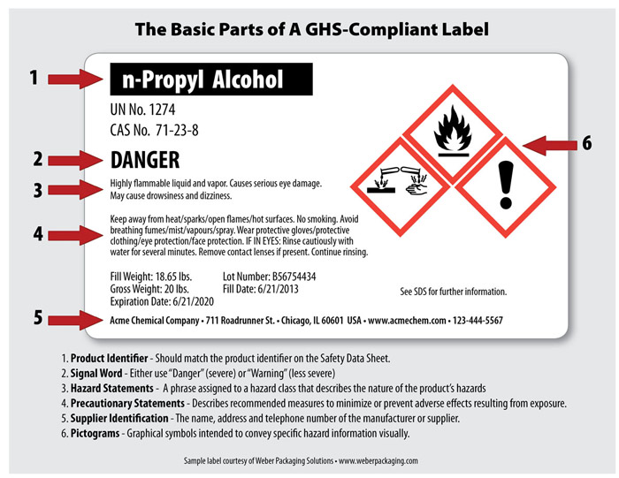
Container Labeling
All employees handling chemicals at the Ragon Institute will verify that all containers of hazardous chemicals received from manufacturers, distributors, or importers are clearly labeled to indicate:
The identity of the contents.
The identity of the contents must match the corresponding SDS.
Appropriate hazard warnings, including routes of entry into the body and the target organs, if known.
The name and address of the manufacturers, importer, or responsible party.

Slide 4
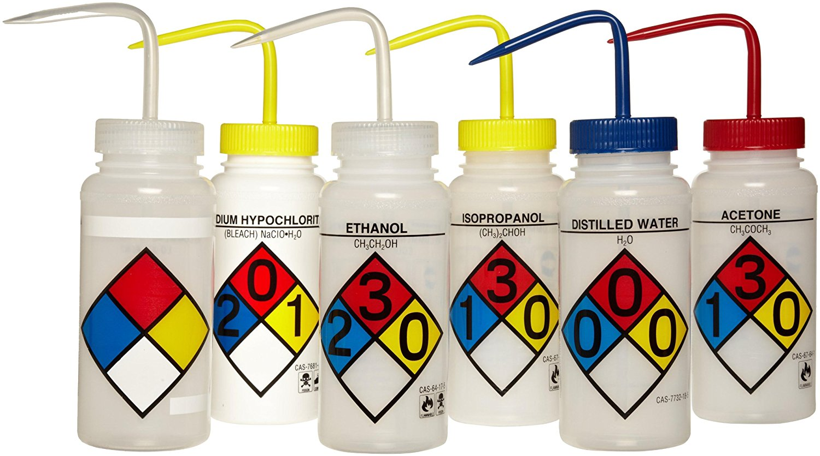
Secondary Container Labeling
Employees will ensure that secondary containers are properly labeled
Secondary containers must be labeled, in English, with the name of the hazardous chemicals (no abbreviations) and the primary hazard.

Slide 5
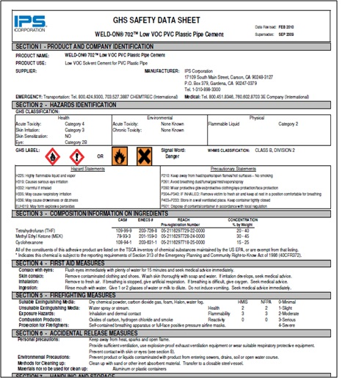
Safety Data Sheets
The SDS is a detailed information bulletin prepared by the manufacturer or importer of a chemical product or chemical substance. It describes the chemical and physical hazards associated with the product or substance, its physical and chemical characteristics, when and how it may be hazardous, the effects of exposure, precautions for safe handling and use, emergency and first aid procedures, and control measures that are applicable.
Access SDS’s via:
Ragon Connect (link to MGH SDS database)
Contact the manufacturer of the product.
Online Web SDS searches.
Contact the EH&S Office.

Slide 6
Flammable Liquid Storage and Volume Limitations

Slide 7
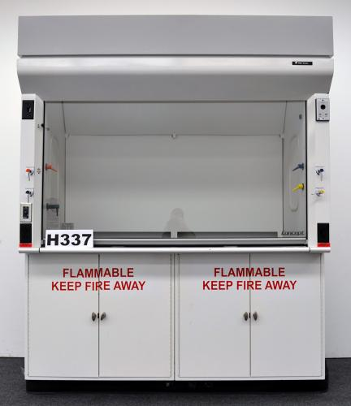
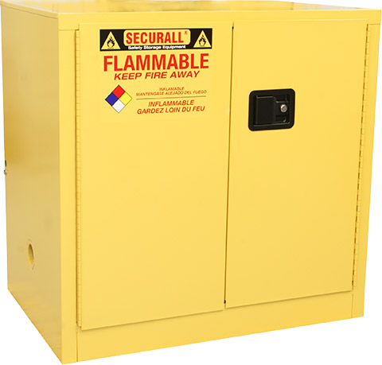
Ragon’s permit from the Cambridge Fire Department requires us to:
Store all stock flammable liquids in a flammable cabinet
Ensure the volume of flammable material is kept below permitted levels

Slide 8
Flammable Liquid Quantity Limits
Allowable Quantities in Flammable Storage Cabinets at Ragon on Floors 7, 8 and 9
In Flammable Storage Cabinets:
24 gal
In closed containers outside Storage Cabinet
eg. working container, spray bottle, squeeze bottle:
12 gal

