Slide 1
Waste Management

Slide 2
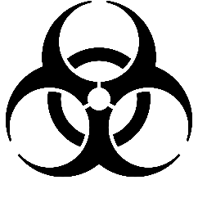
Biohazard Waste
Definition:
  Blood and blood products
  Pathological waste
  Cultures and stocks of infectious agents and associated materials
  Contaminated infectious animal waste
  Sharps (anything physically dangerous that can poke/puncture/cut/scrape even if it is not biologically contaminated)
  Biotech by-product effluents (liquids)

Slide 3
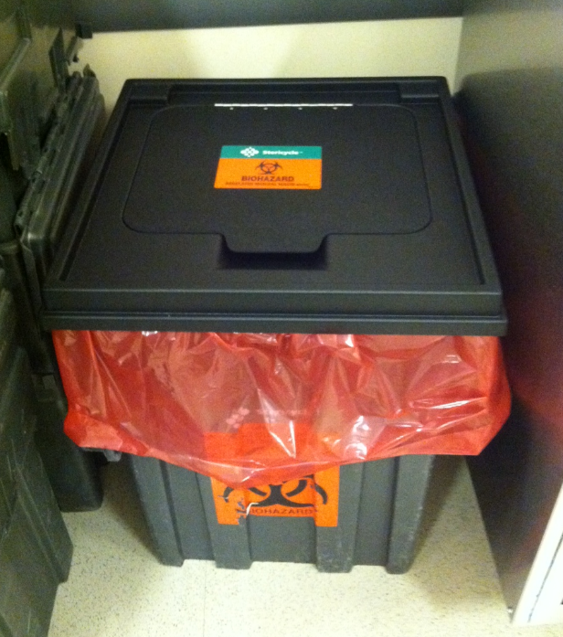
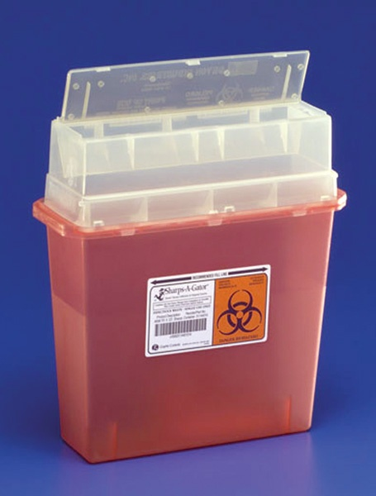
Biohazard Waste in Main Lab
  Biowaste Box
    Utilize for non-sharp and non-liquid biohazardous waste
    Line box with one red biohazard bag
    Cover box when not in use (end of day, when not in use)
  Sharps Container
    Utilize for sharp items (syringes, lancets, glass pasteur pipettes, broken glass, blades, etc.) – regardless of whether they are biocontaminated!
  Liquid Waste
    Render non-infectious by chemical treatment with approved disinfectant
    Carefully pour down sink, run water
Chemically contaminated material CANNOT be put into Biowaste containers or down the sink

Slide 4

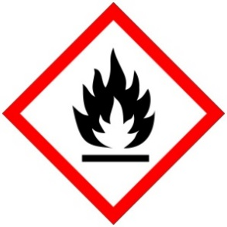
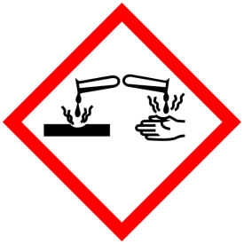
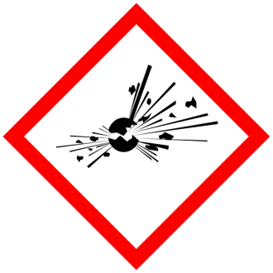
Chemical (Hazardous) Waste
Definition:
  Chemical that exhibits characteristics of being:
    toxic
    flammable
    corrosive
    reactive
  Hazard determination:
    Refer to SDS (safety data sheet)
    Contact EH&S
Chemical waste cannot go down the drain!

Slide 5
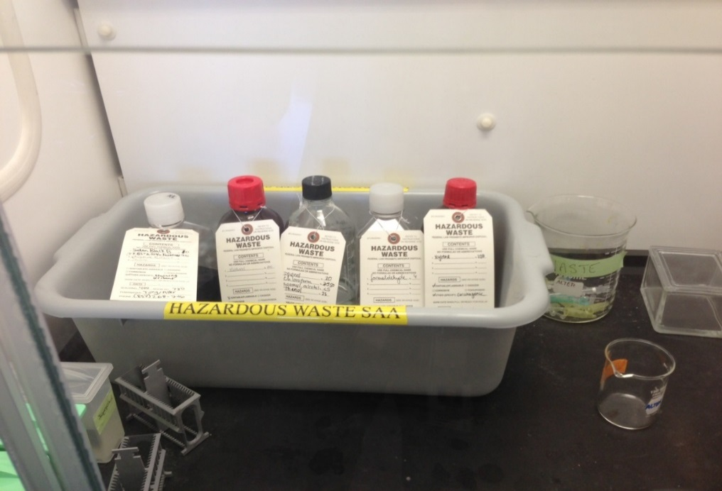
Chemical (Hazardous) Waste
Hazardous Waste Accumulation and Storage takes place in “Satellite Accumulation Areas” or “SAA’s”:
  Typically located in a fume hood
Notes:
SAA
Know location(s) on every floor
5

Slide 6
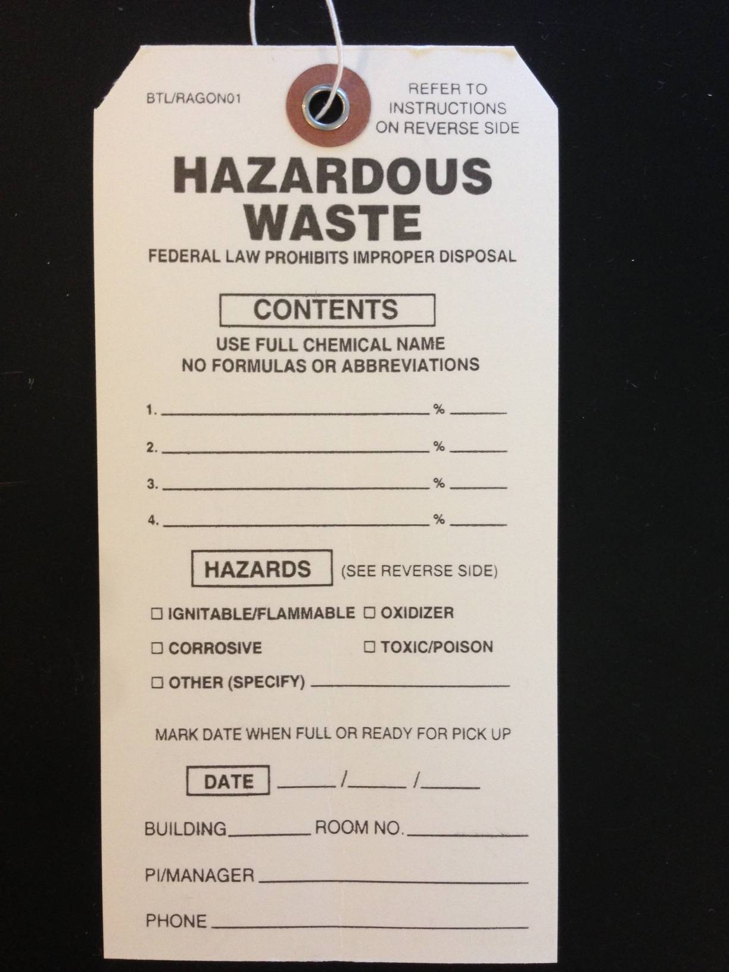
Questions?
mbedford@eheinc.com
All chemicals
Specific Hazards
Location and Contact Information
Notes:
----- Meeting Notes (9/4/13 15:24) -----
if percent can be filled then do it
email kristina when botte is full and dated
6

Slide 7
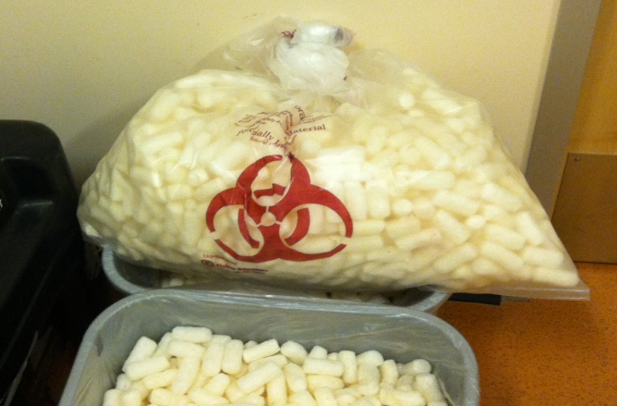
Waste Procedure
Trash (non-hazardous)
  Custodial Staff are trained to remove regular trash from all rooms except tissue culture rooms
  Custodial Staff will not remove trash labeled with hazard symbols
  Empty chemical bottles may be disposed of in the regular trash bin if they have been rinsed and labels are removed or defaced.

Slide 8
Empty Chemical Bottles
Either:
Triple rinse empty bottle, deface label and reuse as a waste bottle
Or:
Clean, empty bottles, with labels removed or defaced can be put in regular trash (not Biohazard Bins)
Bottles that contained acutely hazardous materials of that have a residue that cannot be removed must be tagged and disposed of as chemical waste.

