Slide 1
Sample Movement and Shipping

Slide 2
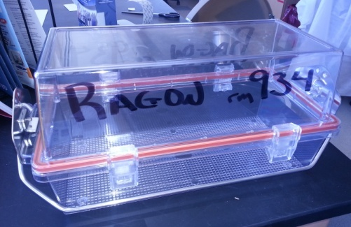
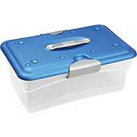
Sample Transport in the Lab
Follow RAGON INSTITUTE ST_SOP_001 found on Ragon Connect
Single vials/tubes can be carried by a gloved hand – never plates. More than 1 item requires a transport container.
**Non-infectious, fixed samples only! And never a virus**
Transport containers must be wiped down with 70% EtOH before leaving TC room
Carried with an ungloved hand
Infectious/non-fixed samples must be in air-tight Nalgene container – see lab manager
Infectious
Non- fixed
fixed
Notes:
There is a detailed SOP about that which we all go trough and don’t pay attention to much until the day we need to TRANSPORT something … and than we look what others do … and we do that not necessarily correct …
FIXED samples plastic clear –blue container – no gloves – must be disinfected with alcohol before removing from TC
Unfixed – autoclavable container – no gloves – disinfected with absorbent , samples locked , safely packed , wrapped … think of dropping that …

Slide 3
Sample Transport Between Floors
Never carry samples through carpeted areas/tea room
Use Stairway 2 outside elevator lobby
Use freight elevator to transport large number of samples or packages. You can use cart and wear lab coat in this elevator. No samples or lab related items are allowed in the passenger elevators
NEVER leave samples unattended in a public space (i.e. outside elevator, in stairwell etc)
** in addition to samples, no PPE or lab reagents/supplies are allowed in the office area and tea room **

Slide 4
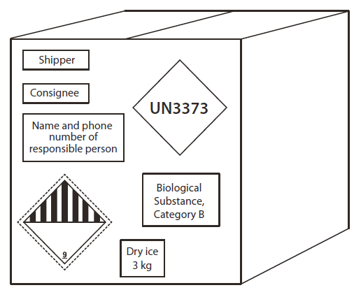
Shipping Research Samples
Shipping and transport of samples is highly regulated by DOT and IATA.
Fines, bad press, and jail time are possible if you don’t comply!
Training required every 2 years:
https://hub.partners.org/register/
If you do not have DOT/IATA training DO NOT prepare or pack a sample or sign shipping papers

Slide 5
Modes of Transportation
Mode of Transportation | Yes or No | Notes
Partners Shuttle | YES
Carrier (e.g. FedEx) | YES
Walking | YES | Use tote bag
Biking | YES (not preferred) | Use tote bag
Taxi | YES | If they agree
Moped | NO
Personal or Rental Vehicle, Lyft, Uber Etc | NO
Public Transportation | NO

