Slide 1
Dress Code and
Personal Protective Equipment

Slide 2
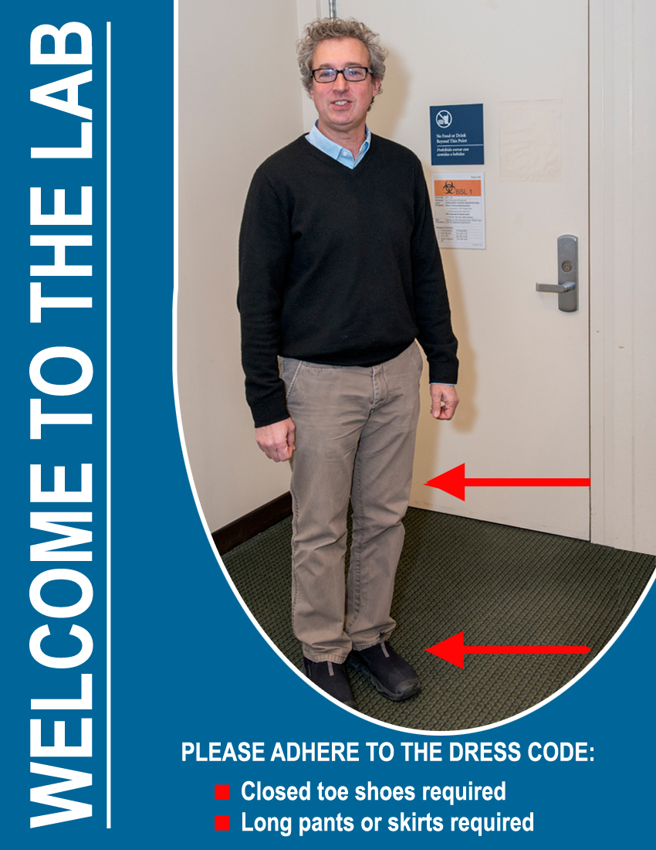
Lab Dress Code
Policy reflects MGH, NIH, OSHA, Federal, State, and City Regulations and Safety Standards
All visitors, guests and administrative staff are required to comply with lab attire policy when entering laboratory space
  Visitor booties, pants and safety glasses available in the 963 EH&S office area
No bare skin exposed below the waist

Slide 3
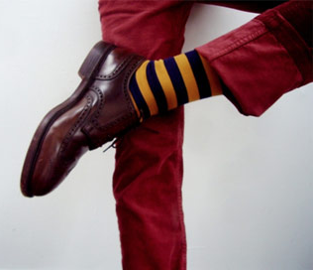
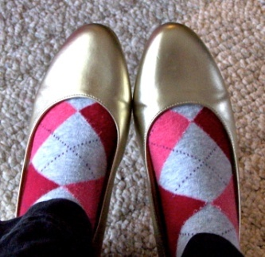
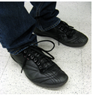

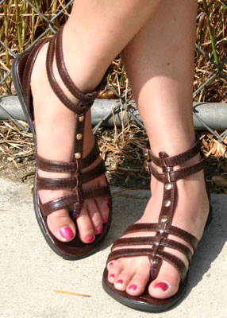
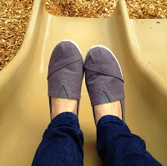
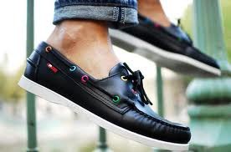
Footwear
Shoes: Must be closed-toe, flats must be worn with socks, stockings etc.
Notes:
3

Slide 4
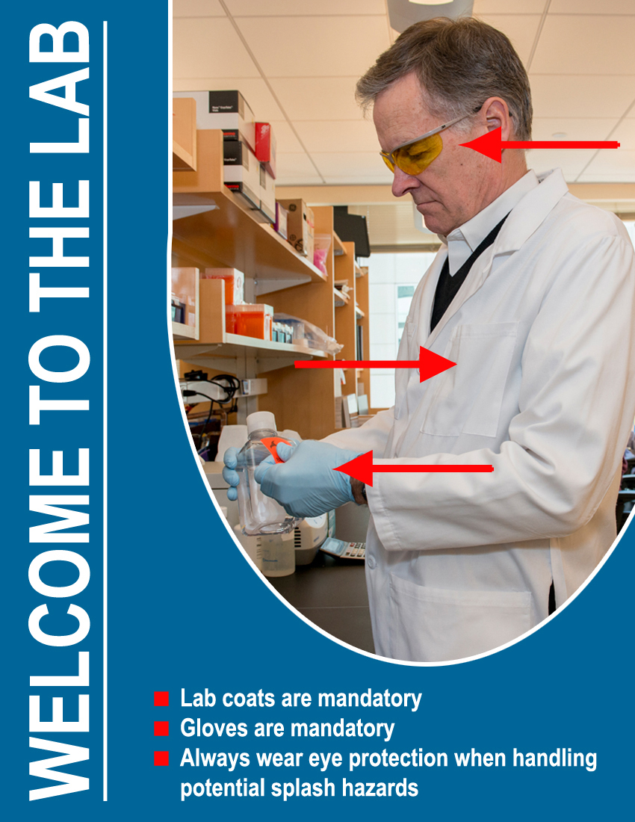
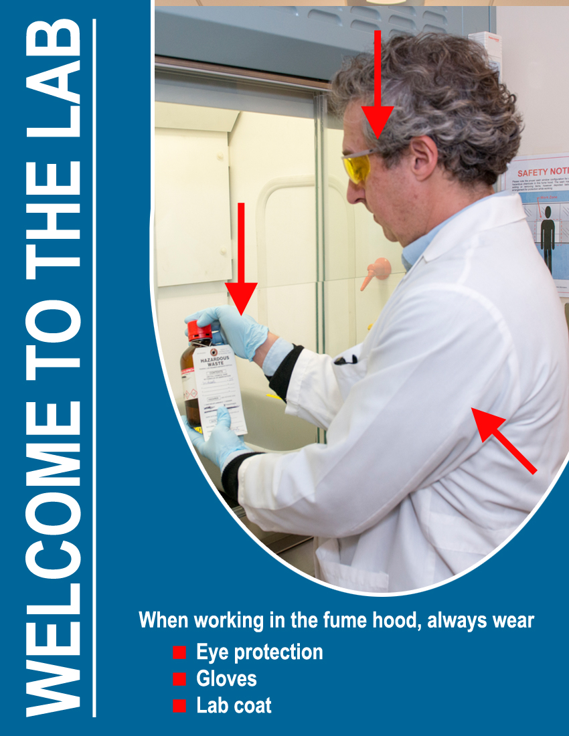
BSL1 (Main laboratory):
All bench work requires lab coat and gloves. Eye protection is required if working with hazardous materials
Fume hood: lab coat, gloves and eye protection are mandatory

Slide 5
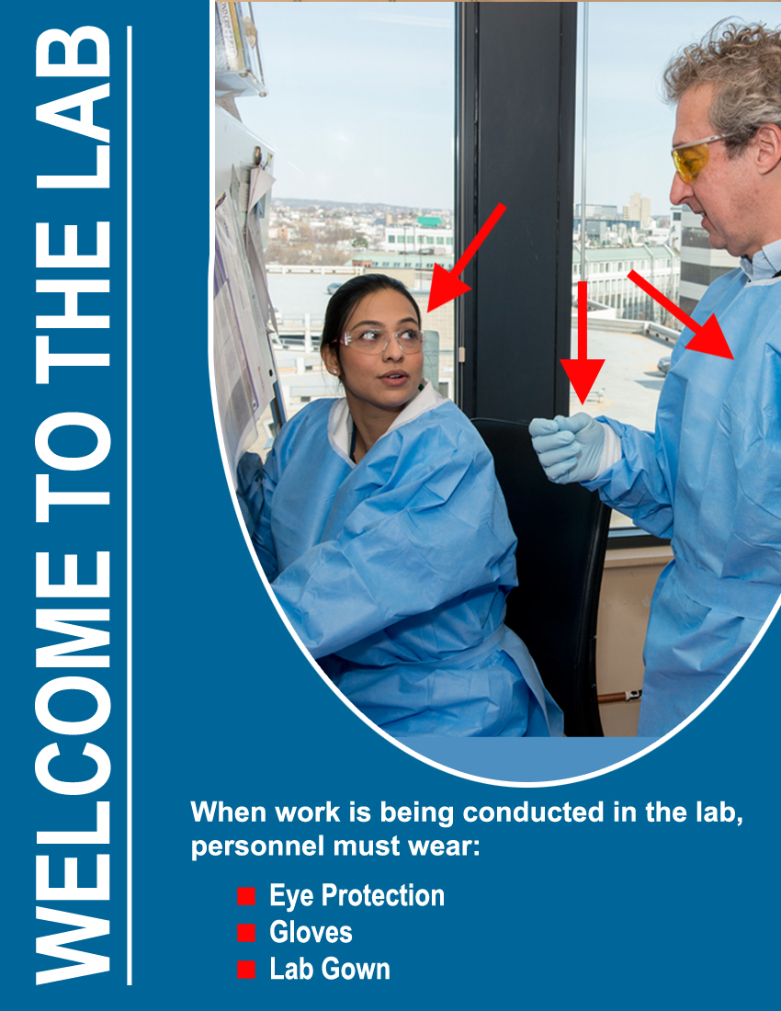
BSL2+ (Tissue culture spaces):
When work is being
performed:
Safety glasses
Disposable gloves
Solid front disposable gown

Slide 6
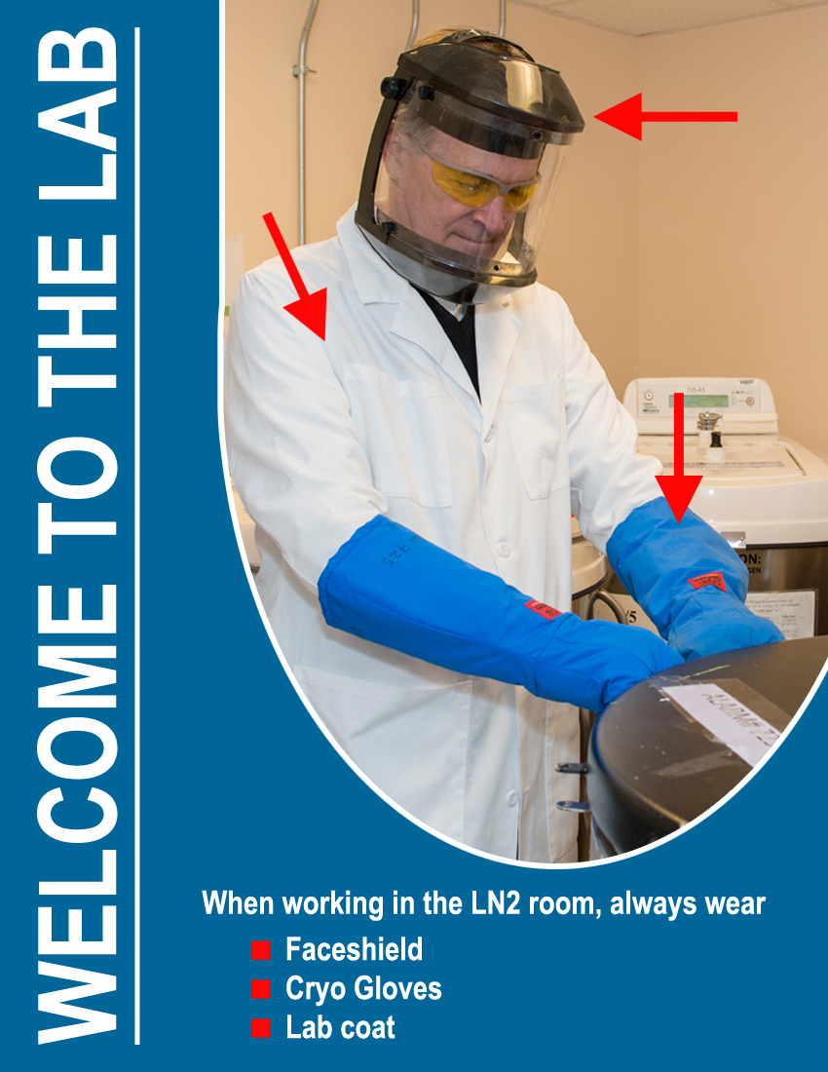
Working with LN2 (cryogenic material):
Laboratory coat
Cryogenic (insulated) gloves
Full face shield and safety glasses

Slide 7
General Housekeeping

Slide 8
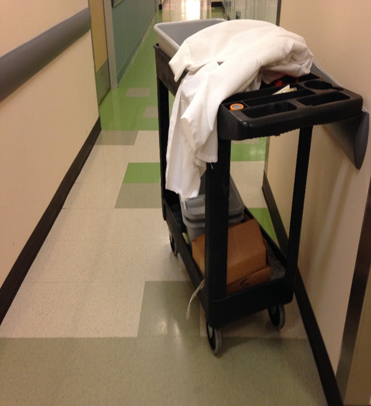
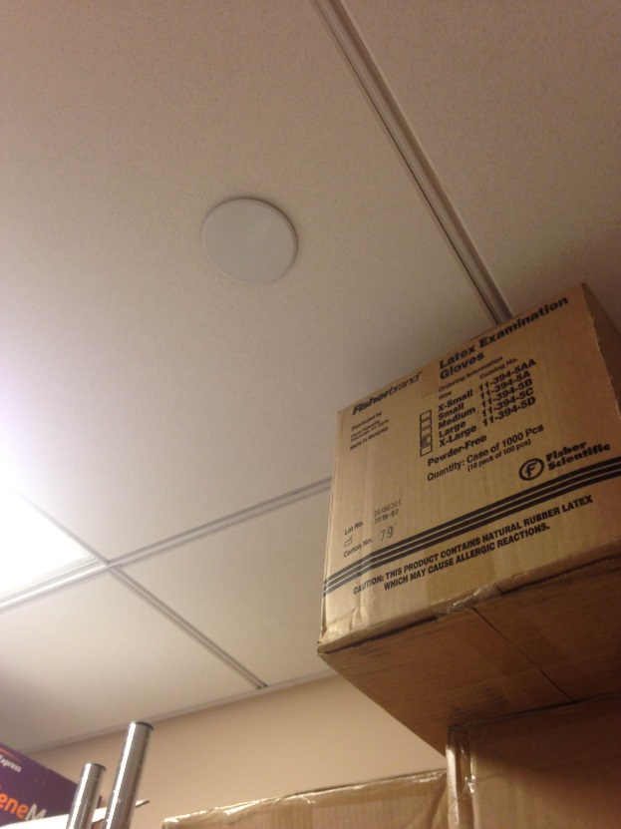
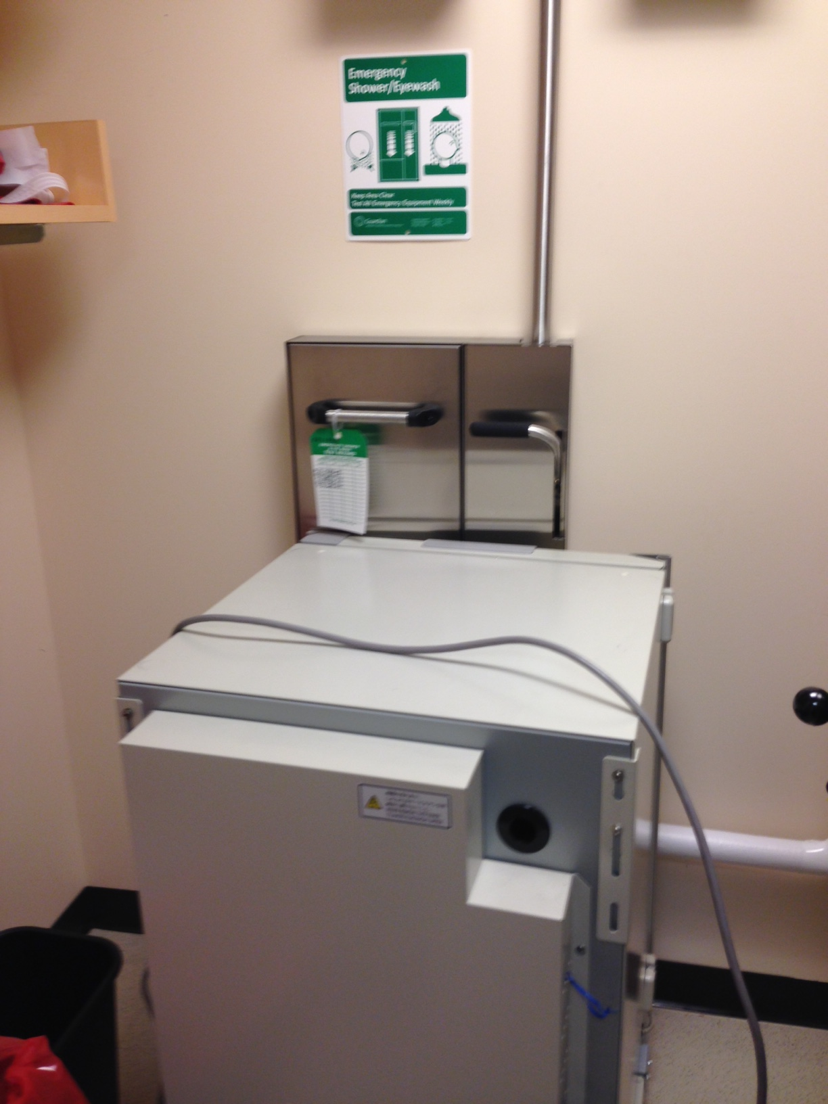
Keeps aisles and doorways clear of trip hazards (minimum 3ft)
Do not block emergency equipment
Do not store materials within 18” of the ceiling or 18” of a sprinkler

Slide 9
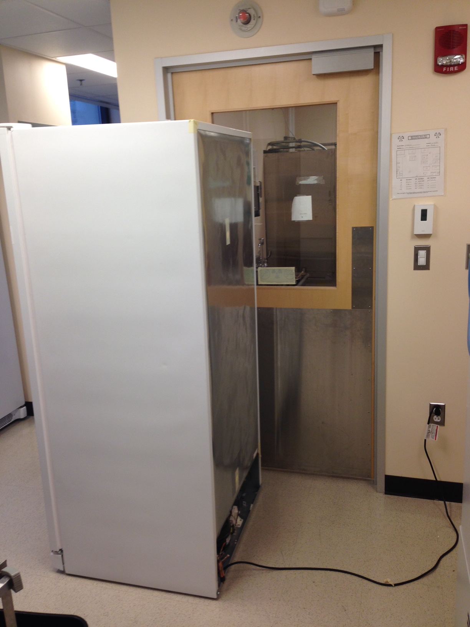
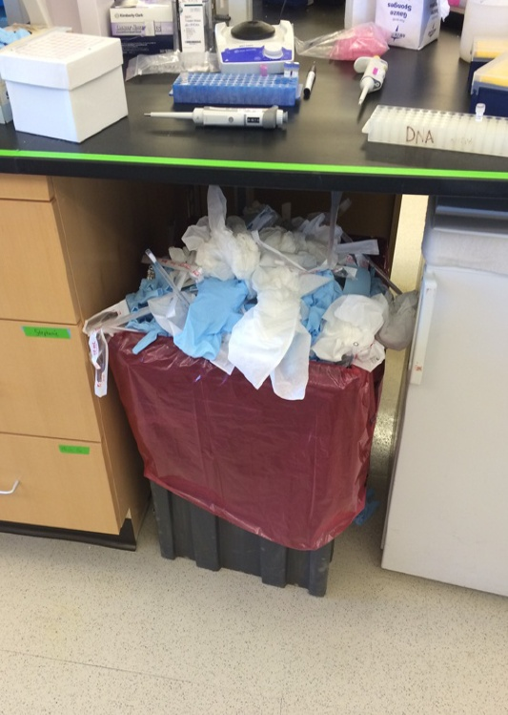
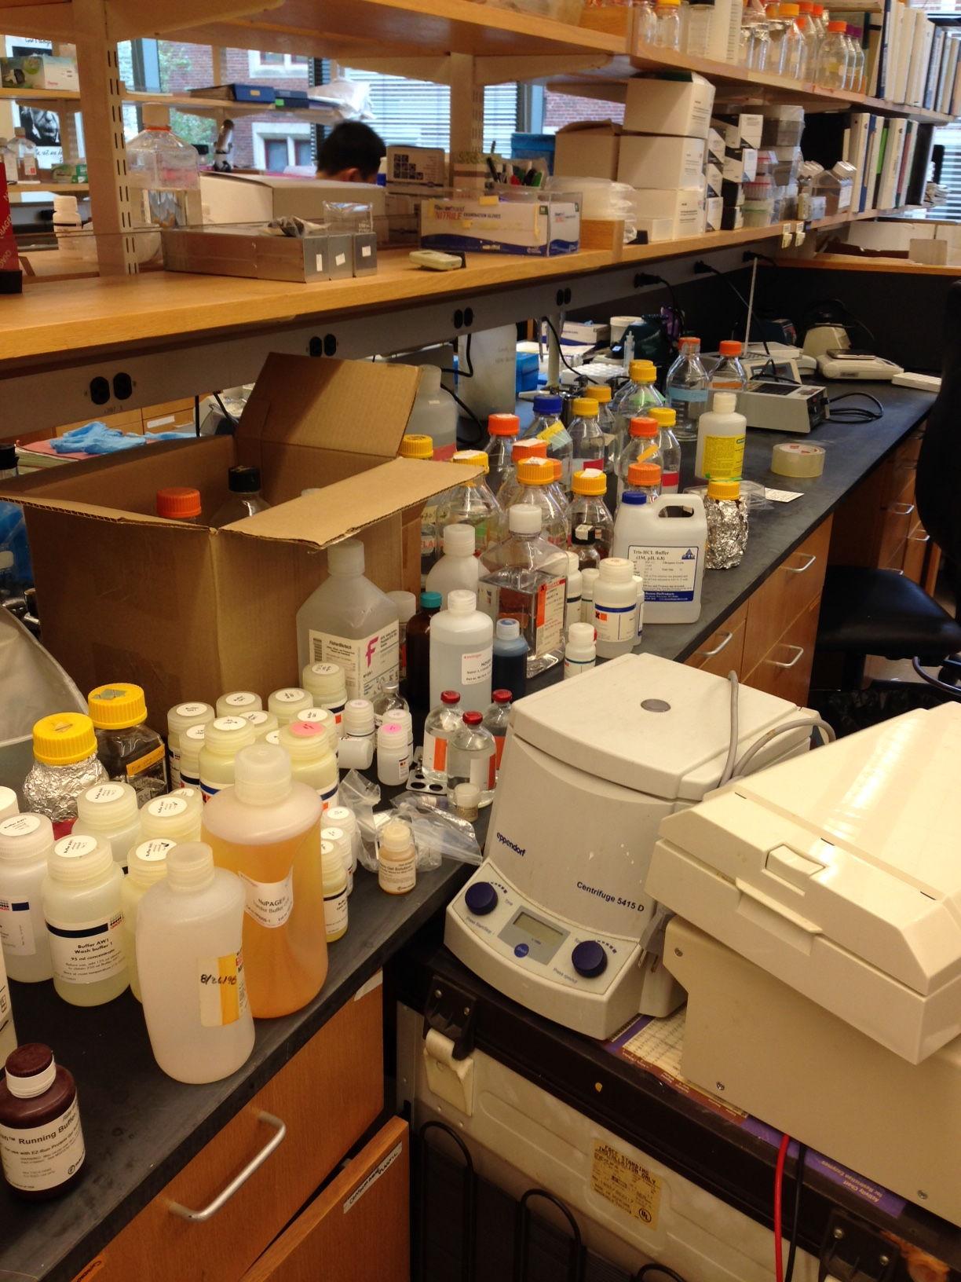
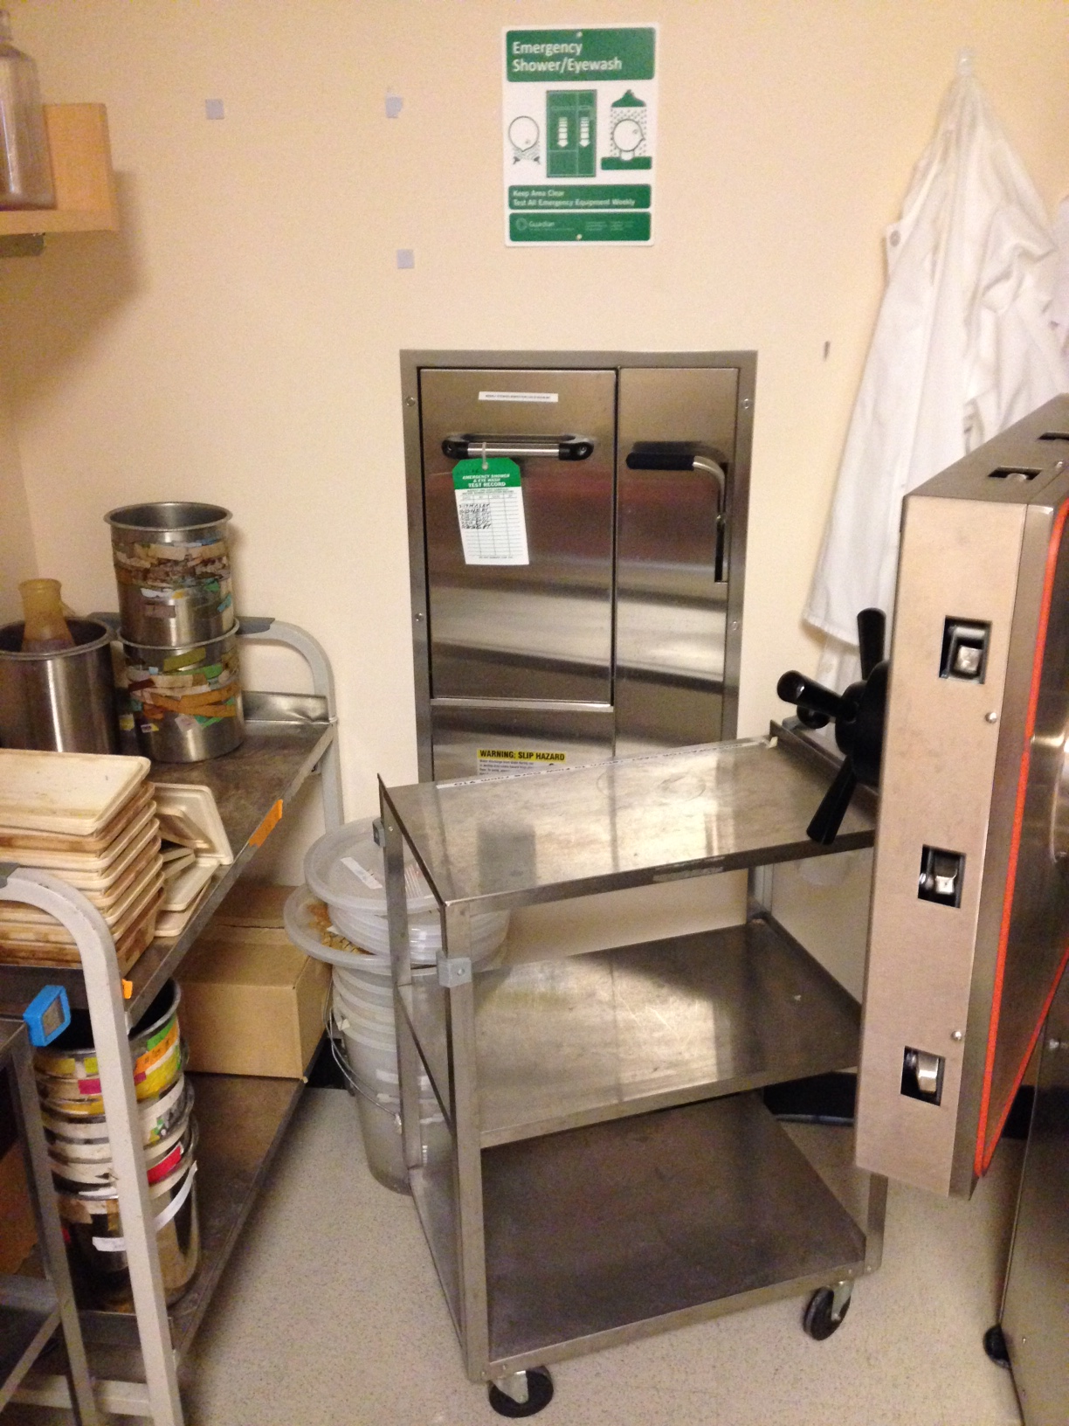
You are responsible for keeping your work areas clean, tidy and free of obstructions
Notes:
Really ?
It took several days for many many people walk by and ignoring that !
And that is not only the waste _ the benches often look like mess , like somebody just stepped out and got kidnapped since nothing has been done to that place….. But even so – the remaining people who have not been snatched by aliens yet should clean that before departure !

