Slide 1
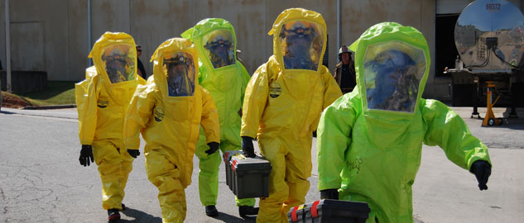
Spill Response Training

Slide 2
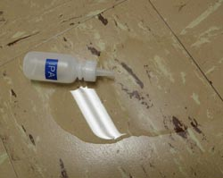
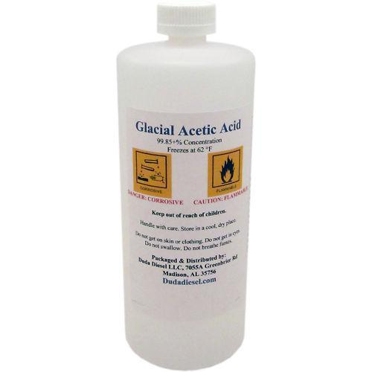
Incidental vs Emergency Spills

Slide 3
How to decide if a spill is incidental?
Size of Spill
Ragon Spill Kits can handle spills<1 gallon of liquid
Hazards of Spill(See SDS)
Water, Ethanol, PBS, etc.=Ok to clean
Phenol/Chloroform, Hydrofluoric acid, BME etc.=Not Ok to Clean
Location
Can you safely reach the spill
Training
Do you know how to clean it
PPE
Do you have the necessary PPE? (Check SDS for recommendations)
Are you comfortable cleaning it?
If you need more than a lab coat, safety glasses, and gloves, do not clean.

Slide 4
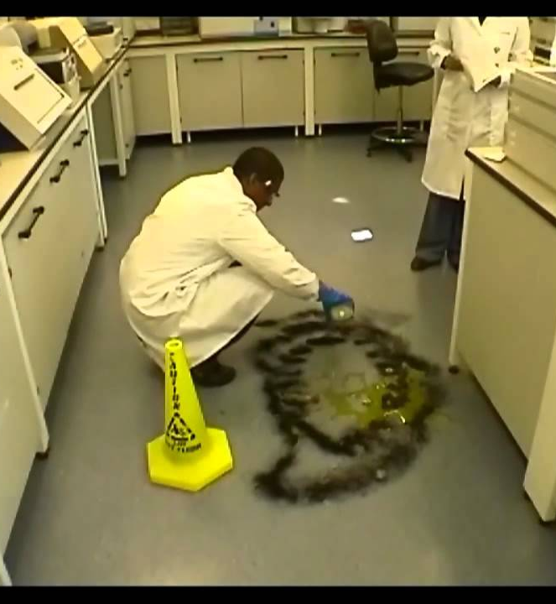
Incidental Response
Warn others in area of spill, use the buddy system
If you aren’t involved in cleaning the spill, leave the area
Wear appropriate PPE
Clean spill using materials from spill kit
Absorbent powder, scoop, brush, spill pads
Bag spill debris, label with HazWaste Tag, place in SAA

Slide 5
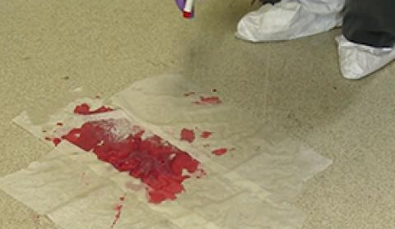
Incidental Biological Spill Response
If the spill is biological, clear the area and wait at least 10 minutes before beginning clean up to allow aerosolized particles to settle.
Wear appropriate PPE
Encircle spill with absorbent
Cover spill with paper towels/spill pads to prevent splashing
Pour absorbent over the spill
Bag all spill debris and place in biowaste bin
Disinfect area with 10% bleach solution

Slide 6
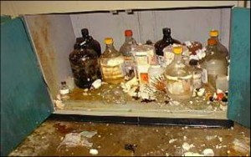
Emergency Spills
If the spill isn’t incidental, it’s an emergency
To clean an emergency spill you must have OSHA HAZWOPER certification
Do not attempt to clean spill yourself

Slide 7
Emergency Response
Warn others and evacuate the area
Secure the area to limit access
Report spill to EH&S from a safe location
Call 911 if immediate life threatening emergency
Wait for responders in a safe location

