Slide 1
2017 Ragon Safety Refresher
Alicja Piechocka Trocha
Amruta Samant
Theodore Myatt
Matthew Bedford

Slide 2
Proper PPE (BSL2+, chemical hood, main lab)- A&A
Main lab Areas:
Closed toe foot ware
Clothing that covers lower body
PPE removed prior to exiting
Booties, Tyvek pants for VISITORS only!

Slide 3
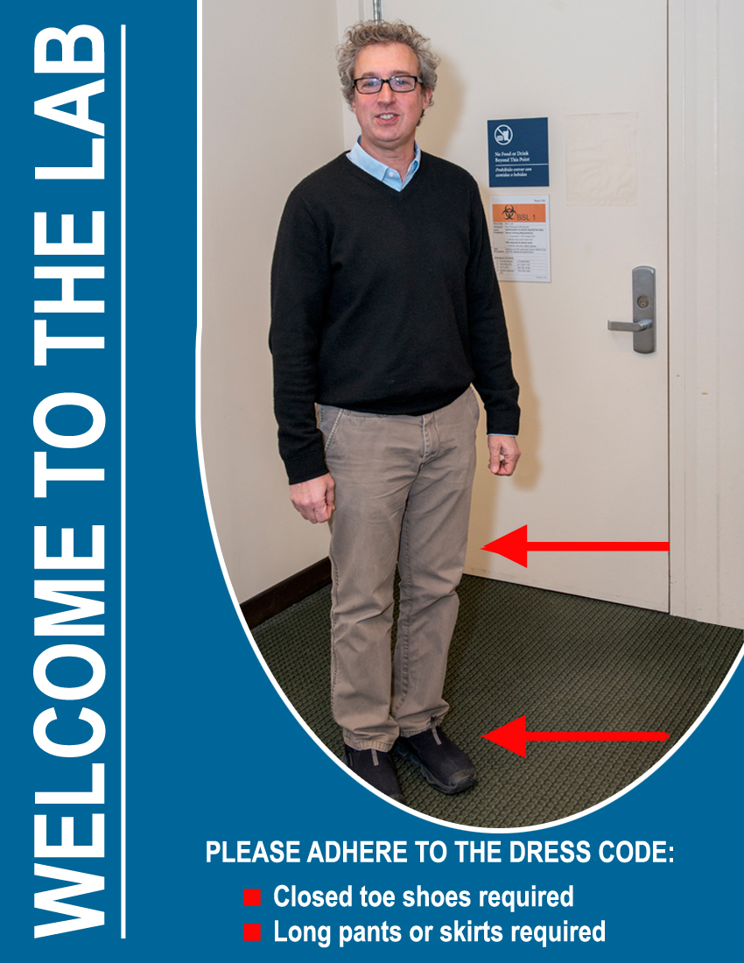
Ragon Dress Code

Slide 4
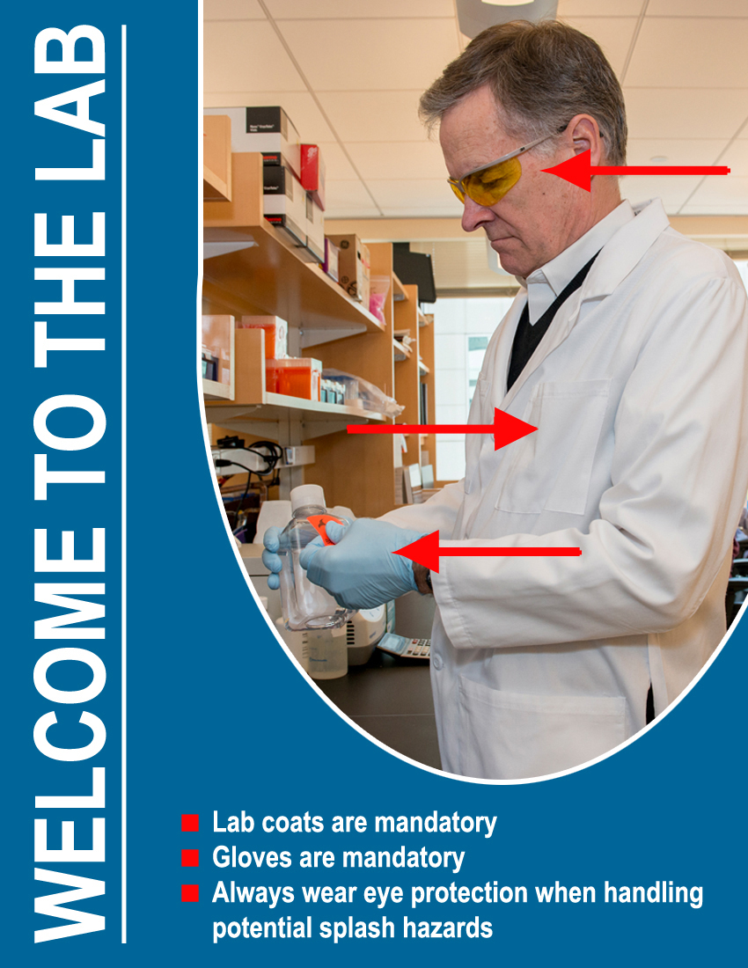
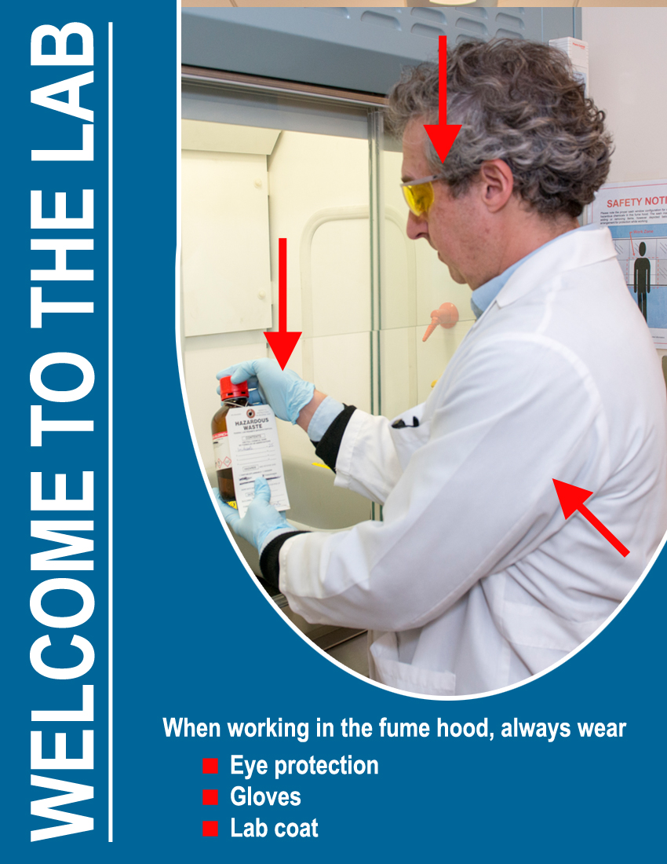
2) BSL1 (Main laboratory):
All work requires lab coat and gloves
Fume hood: lab coat, gloves and eye protection

Slide 5
UV transilluminator: UV protection glasses or UV protection face shield
Eye protection: for any potential splash hazards
(M)SDS to be used if unsure of the material

Slide 6
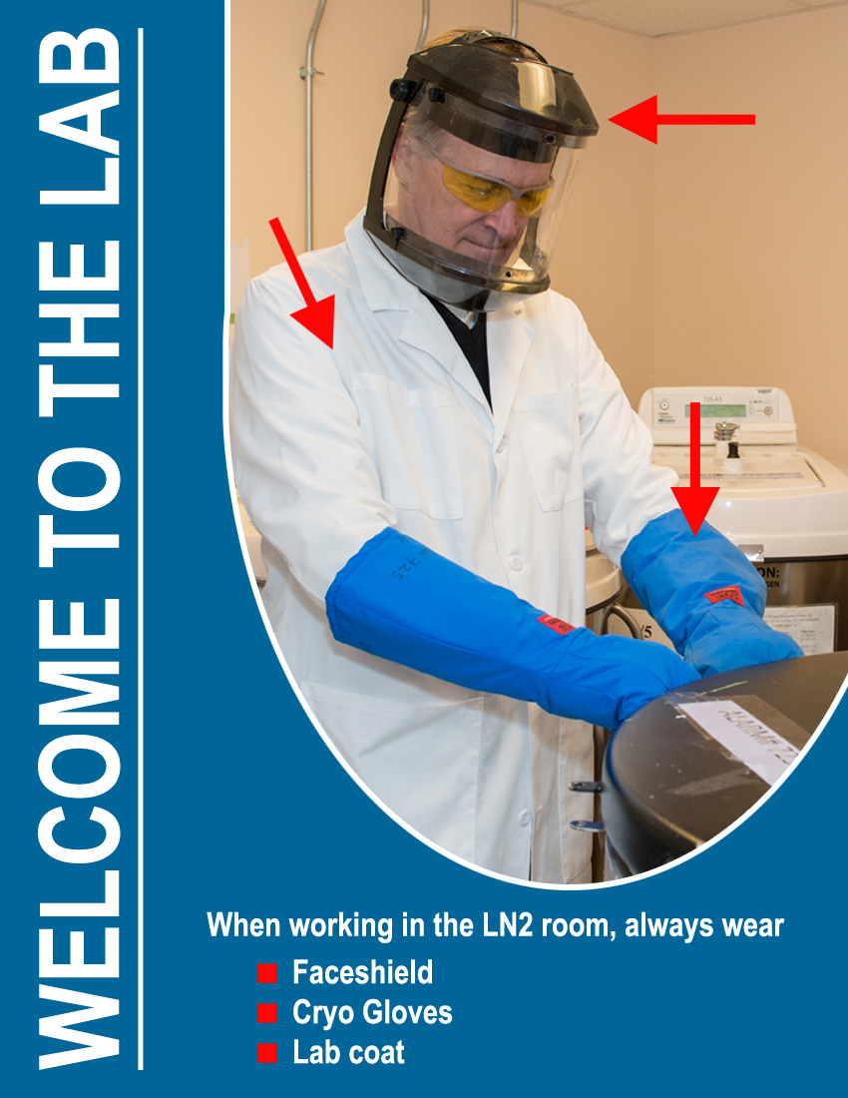
3) Working with LN2 (cryogenic material):
Laboratory coat
Cryogenic (insulated) gloves
Full face shield

Slide 7
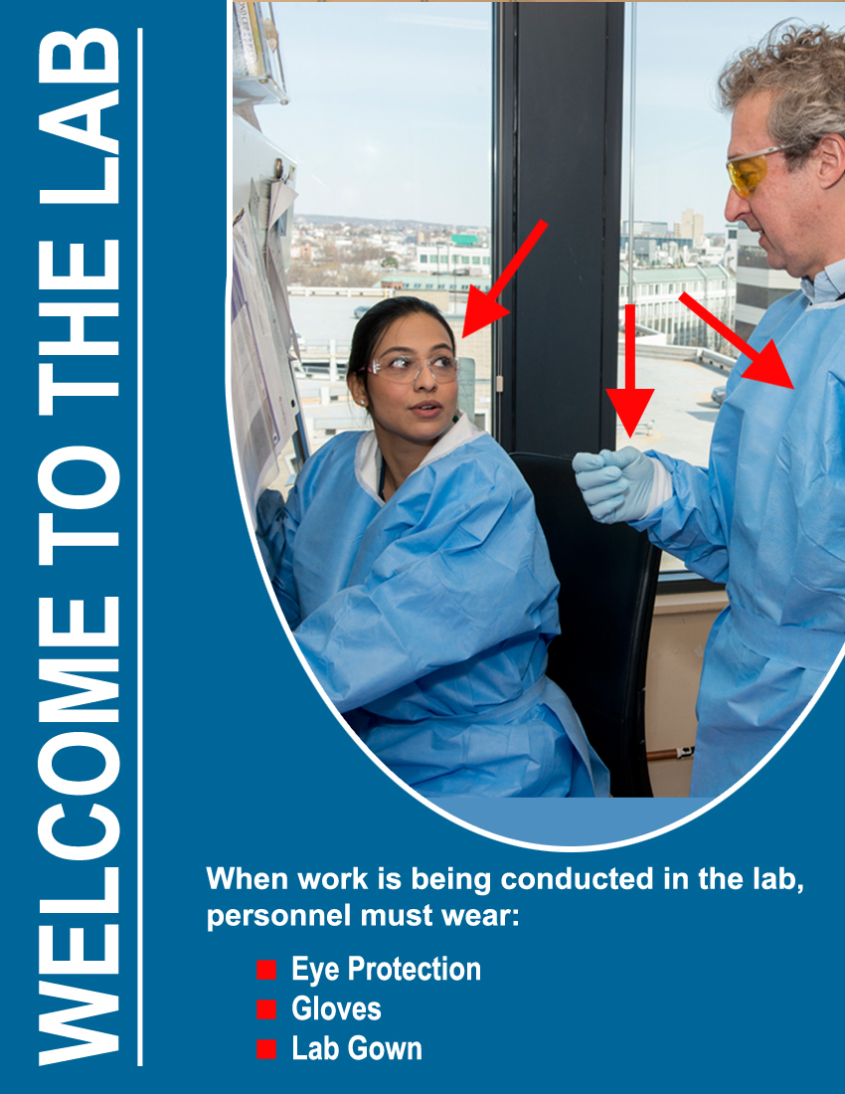
4) BSL2+ (Tissue culture spaces):
When work is being
performed:
Safety glasses
Disposable gloves
Solid front disposable gown

Slide 8
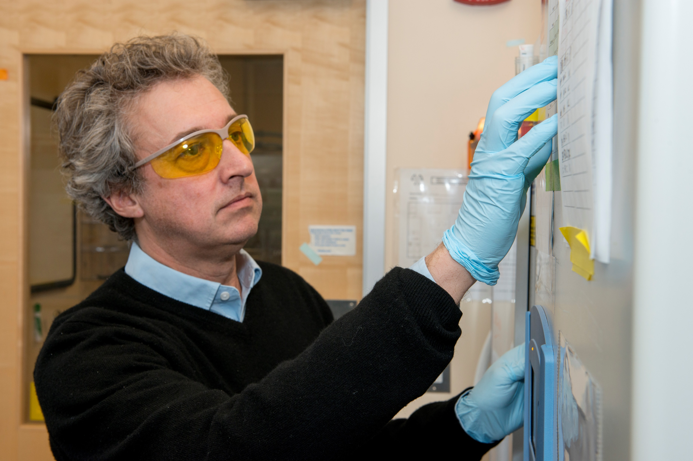
When no work is being performed:
Disposable gloves (mandatory)

Slide 9
Autoclaves
Never autoclave clean and dirty stuff together !
Liquid cycle – for any dirty waste or clean stuff to sterilize which contains liquid, pipettes in the coffins
Dry cycle : dry biohazard bags, clean Eppendorf tubes to sterilize
Autoclave validation: must be done every 3 months (SOP 36-00)

Slide 10
121⁰ C, 15 psi!!
Please wear a lab coat and heat protective gloves when handling
Waste should be loaded from dirty side (tissue culture lab side) and unloaded from clean side (ante room)
Ensure that both side doors are shut!
Drain valve to be cleaned and checked after every run!

Slide 11
Autoclave Images- Drain valve

Slide 12
BL2+ Safety and Proper operation
2nd Pair of gloves –ONLY IN THE HOOD
Proper bucket preparation and disposal
Liquid and dry waste disposal and Hood Spill procedure
Regular trash removal
Laboratory Organization
Notes:
Gloves only in the hood / check for supplies before so you don’t have to leave in sec/ make hole in the bag and fill ½ bucket / check if Vaccum flask is not too full
Helpa filters must be clean/ gauze to cover spills/ d125 and alcohol/ aspirate liquid after inactivating labware/ be organized – it is not your personal bedroom but lab space you share/ be an example to

Slide 13
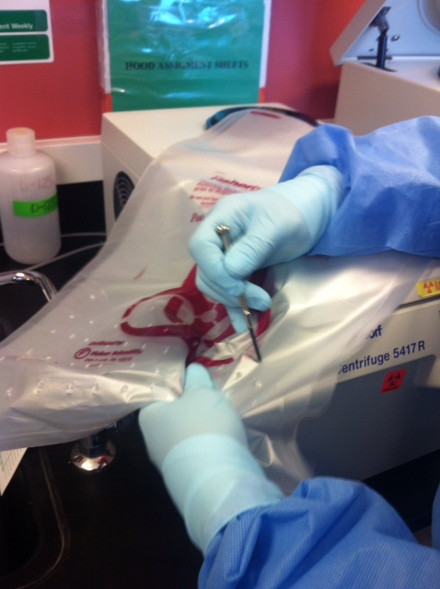
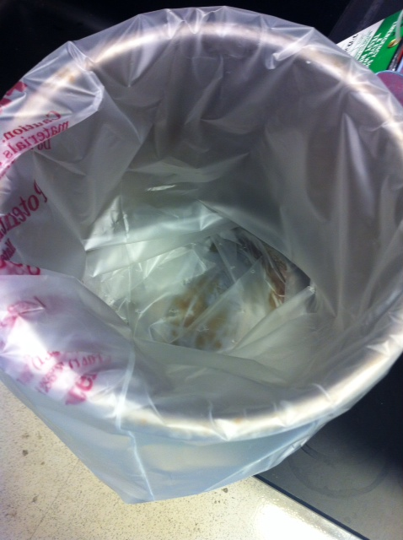
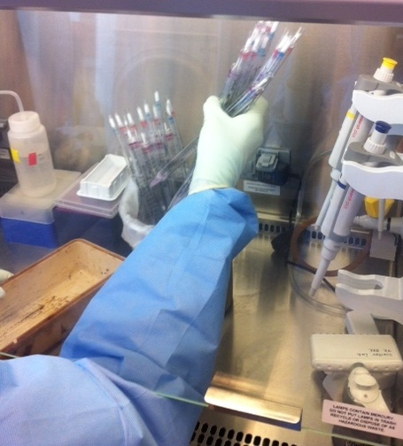
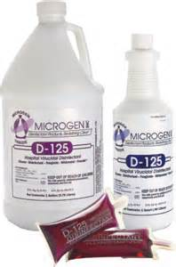
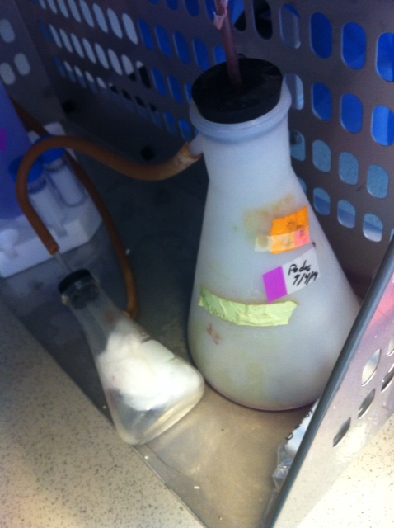
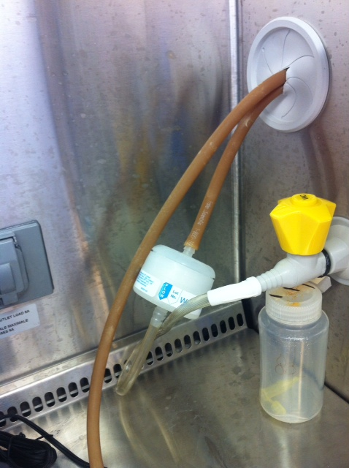
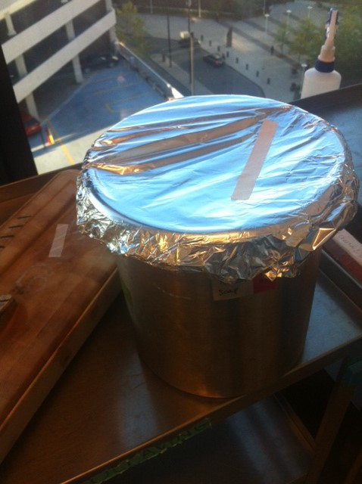
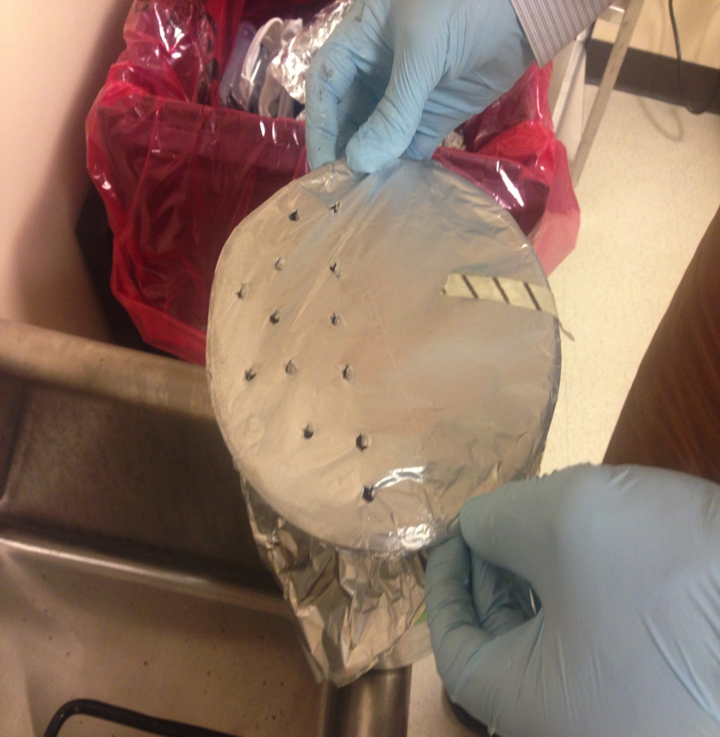
Tissue Culture Course 101
1:64
Notes:
BL2 dress code when working ( or somebody else working there) : lab coat , safety glasses or shield , one pair of gloves
outside the HOOD
HOOD – check D125 dates on bucket inside and vacuum flask below – no older than 7 days and must be filled with liquid
Making new buckets / flasks – use appropriate dilution , poke holes in lining bag for small bucket, check small aspiration flask
-if the gauze soak in liquid - change
Clean your hood with 70% alcohol before and after use/experiment
Dispose all your waste when done with work
Autoclaving dry versus liquid
Biological waste disposal from time of generation to gray gay bin in anteroom:
Each pipet after usage must be filled with D125 before disposing in small bucket
Separate dry and liquid waste :
Dry is outside the hood on the floor –disinfected tubes , plates , flasks
Liquid is in the hood in small bucket- all the liquid from tubes , plates, flasks after inactivation procedure.
Glass ( ACD tubes) proper disposal – biohazard bin
No sharps in the hood ( if must – write SOP and present to EH&S )

Slide 14
Pay attention !
Small buckets in the hood
Plastic ware proper disposal
Pipettes inactivation
NO glass in TC ! Except ACD tubes – dispose in BIOHAZARD
Sharps container
NO sharps in the hood (without approved SOP)

Slide 15
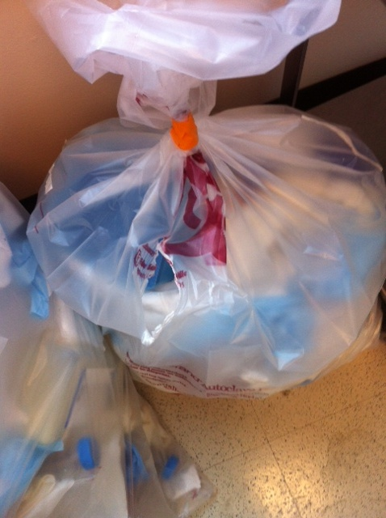
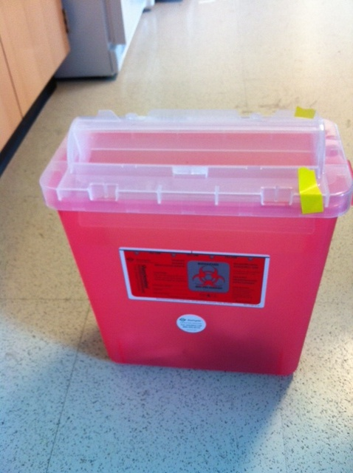
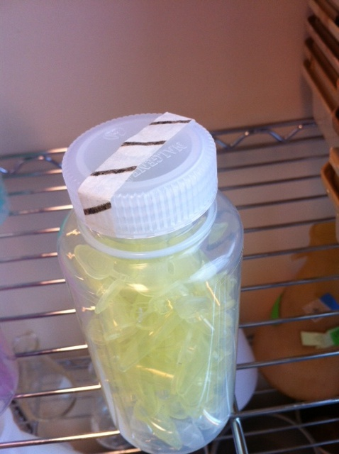
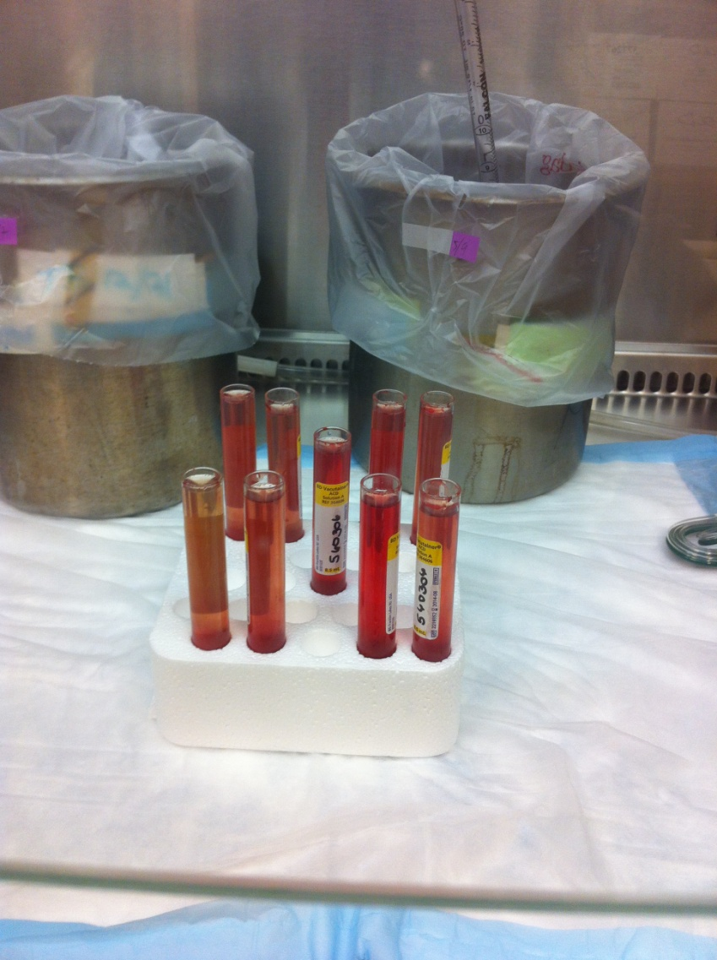
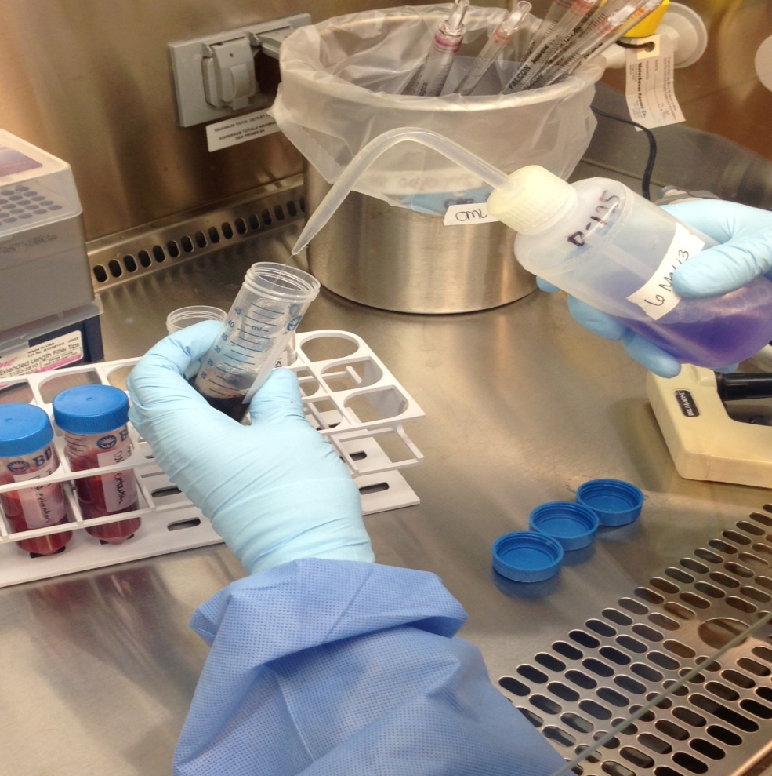
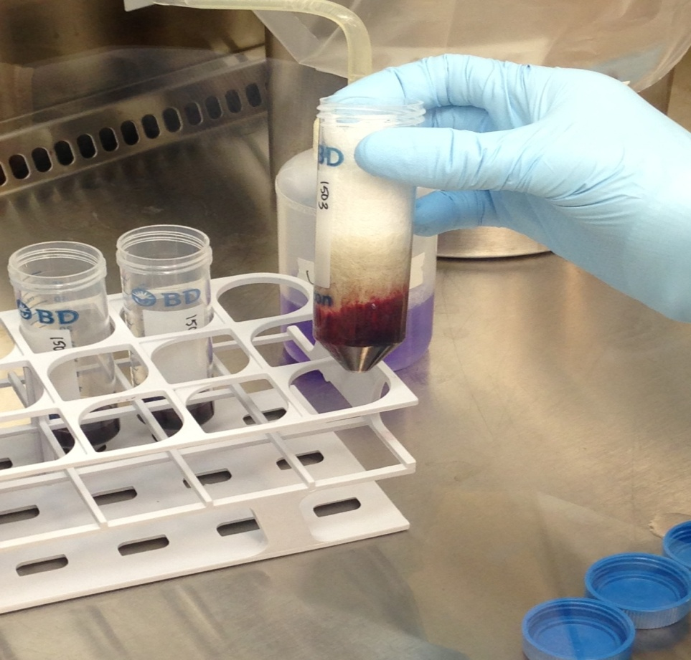

Slide 16
NEVER in the TC room!!!
Wear earphones
Use cell phone
Touch anything with bare hands
Bring sharps (box opener)
Leave your work space without cleaning

Slide 17
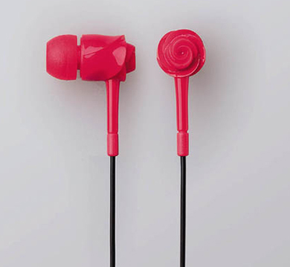

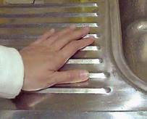
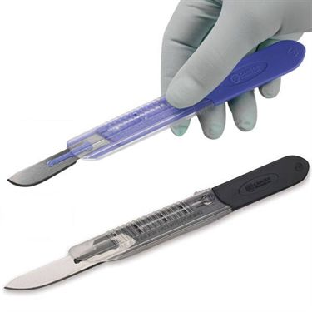
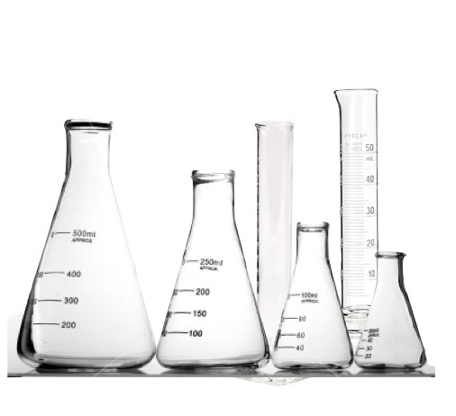

Slide 18
Freezers and LN usage and caring for
Wear full PPE
NEVER put a box on the corner of the open freezer
When LN lid can not close – look for help
Do not have rack too long outside
When rack is broken – do not put it back but rather look for new one
Push – fill button when done
Detail display for your group on the freezer
Scrape the ice build up frequently
Don’t put freezer in alarm and ignore
When emergency move done – make sure temporary location sheet is in place ASAP

Slide 19
What to do when -80 is on alarm –night or during the day
Immediately go and access the problem
If misuse confront and help
If failing follow steps below
Count racks you have to transfer
Inspect your floor EMERGENCY freezer to see how many it can accommodate
Transfer them on the cart -have dry ice on the bottom
Make temporary freezer display to show where the transferred boxes are
Contact group(s) with samples in that freezer so they’re aware of the alarm and samples’ location
Inform floor managers
 | 1
 |  | 2
 |  | 3 | 4
Like this

Slide 20
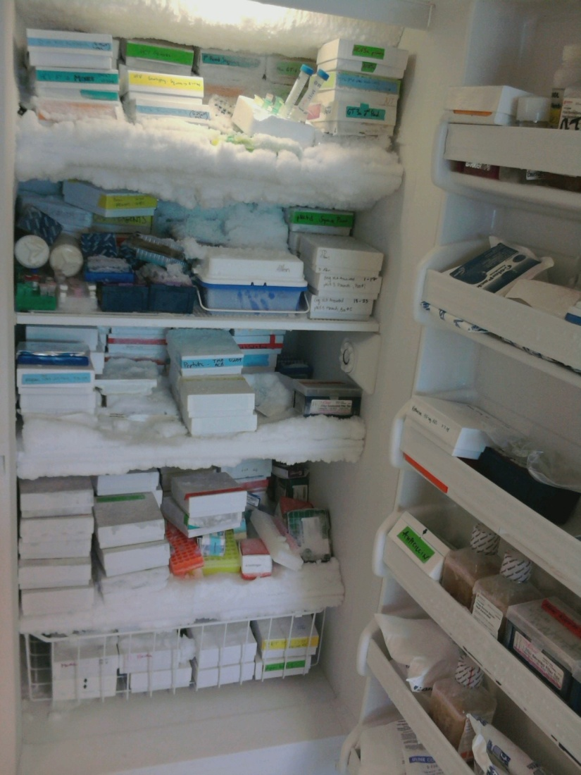
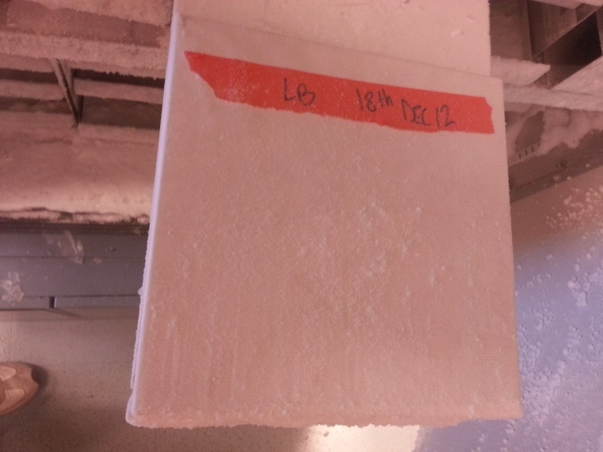
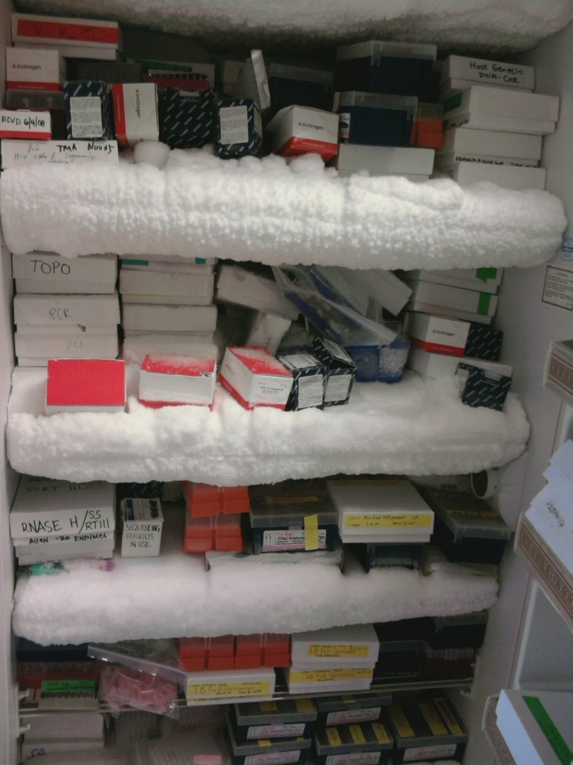
Don’t let let your freezer look like this

Slide 21
Autoclave steam escape
Alarms during the day
Floor duty / responsibility
Supplies courtesy
Clean your work space after your own work
Reduce clutter ! Don’t be hoarder!

Slide 22
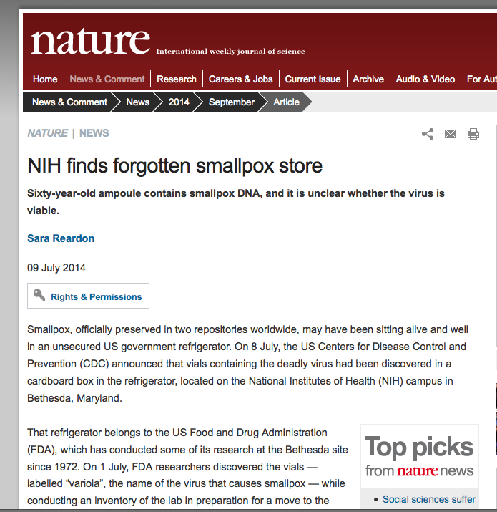
IT is real story

Slide 23
Chemical Waste Management
You are in a new lab area starting a new process that will create two separate waste streams, one is a hydrochloric acid solution, the other is sodium hydroxide
List all the steps to ensure the chemical waste is collected and stored properly.

Slide 24
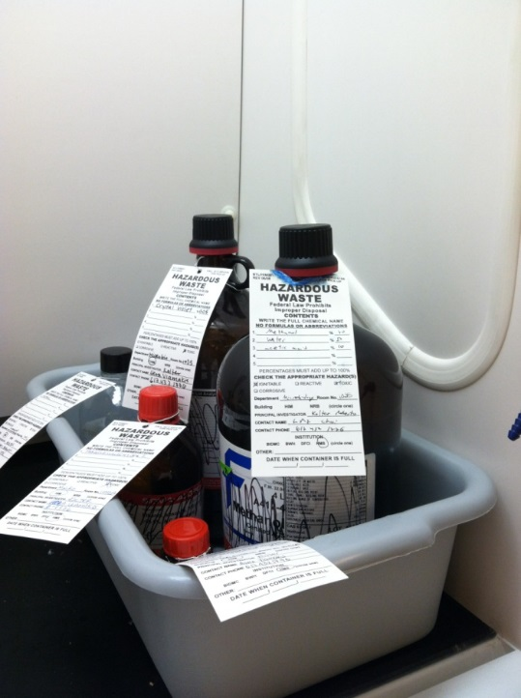
Chemical Waste Management
Hazardous Waste Storage:
  Designated Satellite Accumulation Area (SAA)
    Storage bin designated by SAA sign
    Incompatible chemicals segregated in separate bins
    Containers closed when not in use
    Deface original label of reused containers
    No leaks or spills
    EH&S checks 2x weekly

Slide 25
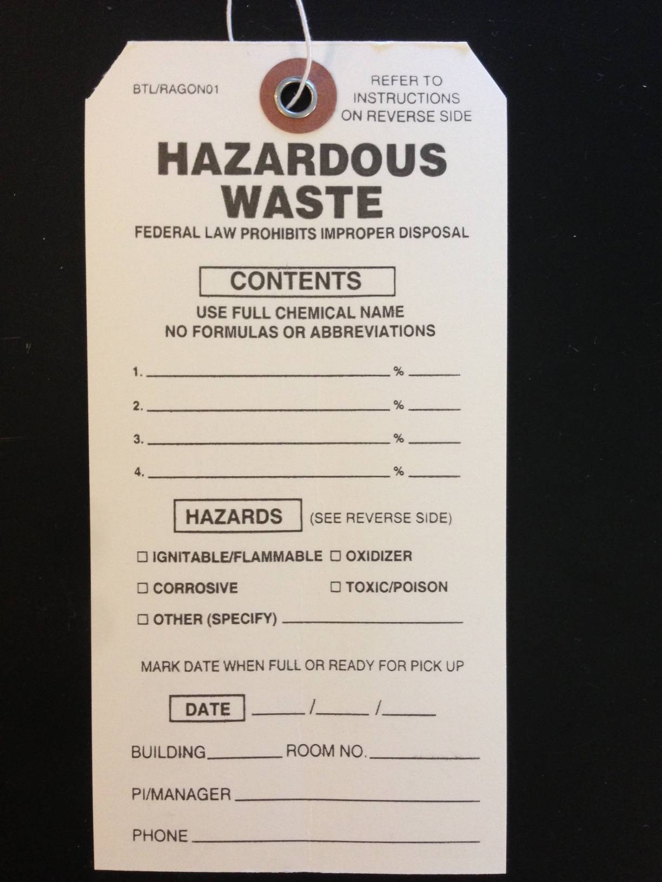
Chemical Waste Management
Instructions and requirements printed on backside of label
Fill out label (except full date)
Abbreviations are not acceptable (e.g., EtOH, H2O)
All chemicals
Specific Hazards
Location and Contact Information
Notes:
----- Meeting Notes (9/4/13 15:24) -----
if percent can be filled then do it
email kristina when botte is full and dated
25

Slide 26
Accidental Exposure
Lab member working with HIV infected blood. During disposal of open blood tubes, 0.5 ml of blood splashed on the conjunctiva of the eye. The blood did not hit the mouth, and the individual did not have lesions on his face.
What steps should be taken?
What could have been done to prevent this exposure?

Slide 27
Ragon Emergency Procedure SOP
Located on RagonConnect (https://ragonconnect.partners.org/).
Describes the steps for handling an accidental exposure, including immediate treatment (e.g., flushing the wound) and contact information for MGH Occupational Health.
In general, for acute injuries, call 911.
When possible, call MGH Occupational Health. They will triage the situation to determine next steps for treatment. They may direct staff to the MGH Occupational Health Office or the MGH Emergency Room.
If the staff member is a student from an area university, they may be directed to their own institution’s student health service. While MGH Occupational Health will triage a situation, nonemployees (e.g., students) will not receive care at MGH Occupational Health.
Notes:
PI’s are responsible for instructing and training staff in practices and procedures related to safety and procedures for dealing with accidents

Slide 28
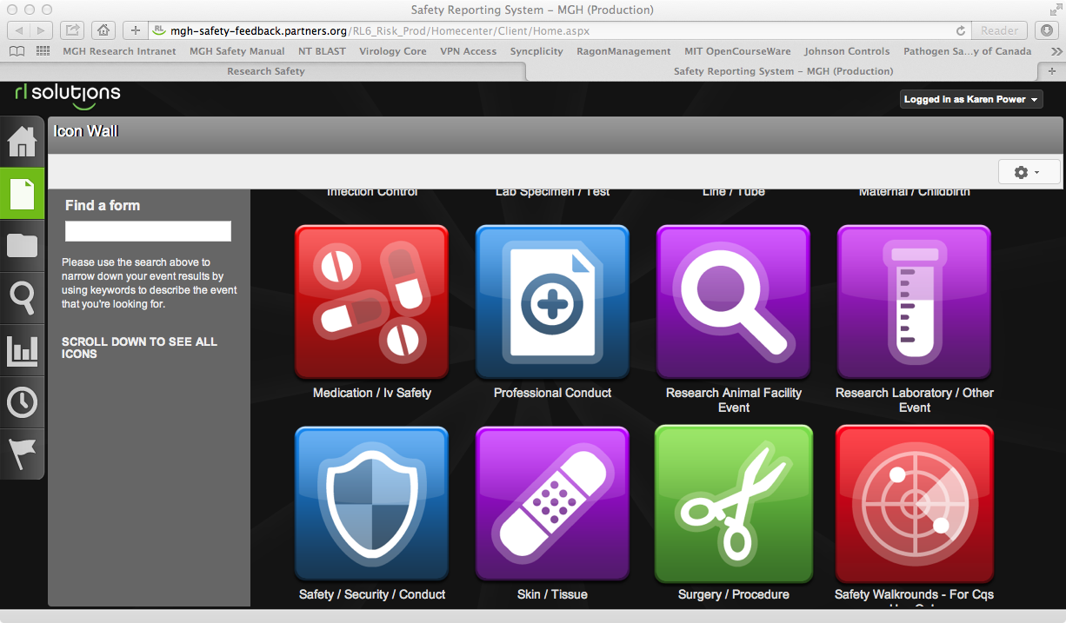
Safety Reporting System
Report all injuries/illnesses/accidents using the MGH Safety Reporting system
Needs to be done on a Partners Computer
http://intranet.massgeneral.org/PARC/ehs.html

Slide 29
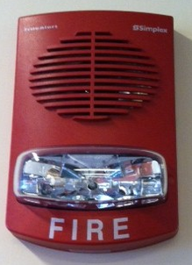
Fire Alarm
Sequence of Events:
  Pre-tone/ Strobe light
  Pre-Recorded Message
    Plays twice
  Evacuation Tone
  Instructional Message
Listen & Respond

Slide 30
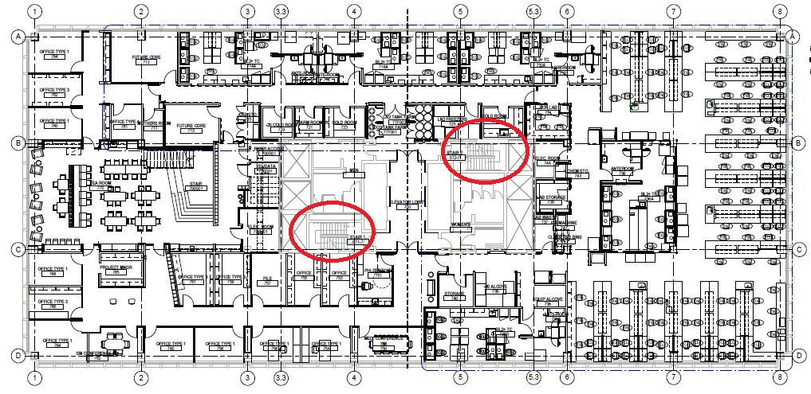
Evacuation Stairwells
Do Not Use Elevators!

Slide 31
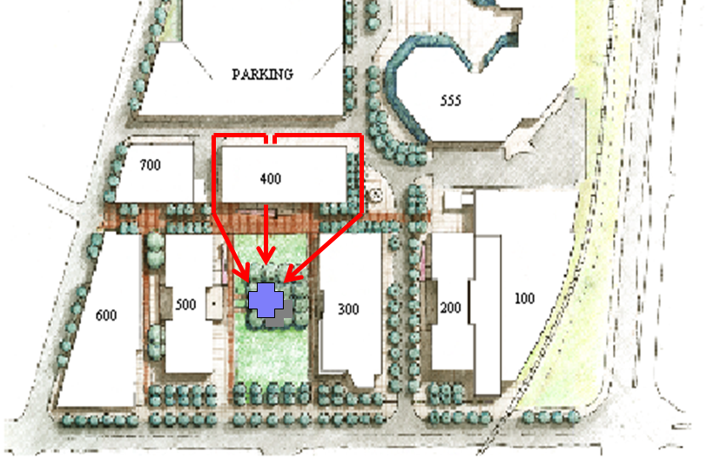
Evacuation Route to Rally Point

